Slide 1
HEUFT spotter ^{II} BFS – Blow-Fill-Seal ampoule inspection machine
Sebastian Mayer – Product Manager Pharma & Healthcare
HEUFT spotter ^{II} BFS – Blow-Fill-Seal ampoule inspection machine

Slide 2

HEUFT spotter ^{II} BFS – Blow-Fill-Seal ampoule inspection machine
GMP - Annex 1 Manufacture of Sterile Medicinal Products
Finishing of sterile products
“(…) Containers closed by fusion, e.g. Form-Fill-Seal Small Volume Parenteral (SVP) & Large Volume Parenteral (LVP) bags, glass or plastic ampoules, should be subject to 100% integrity testing. (…)”

Slide 3
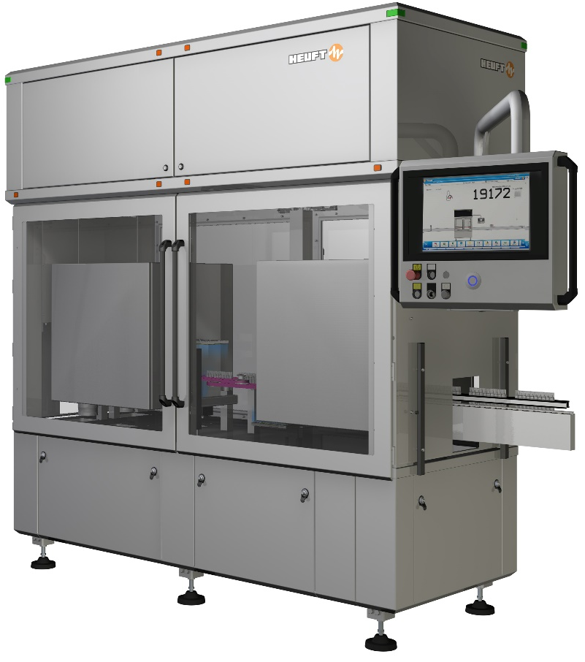



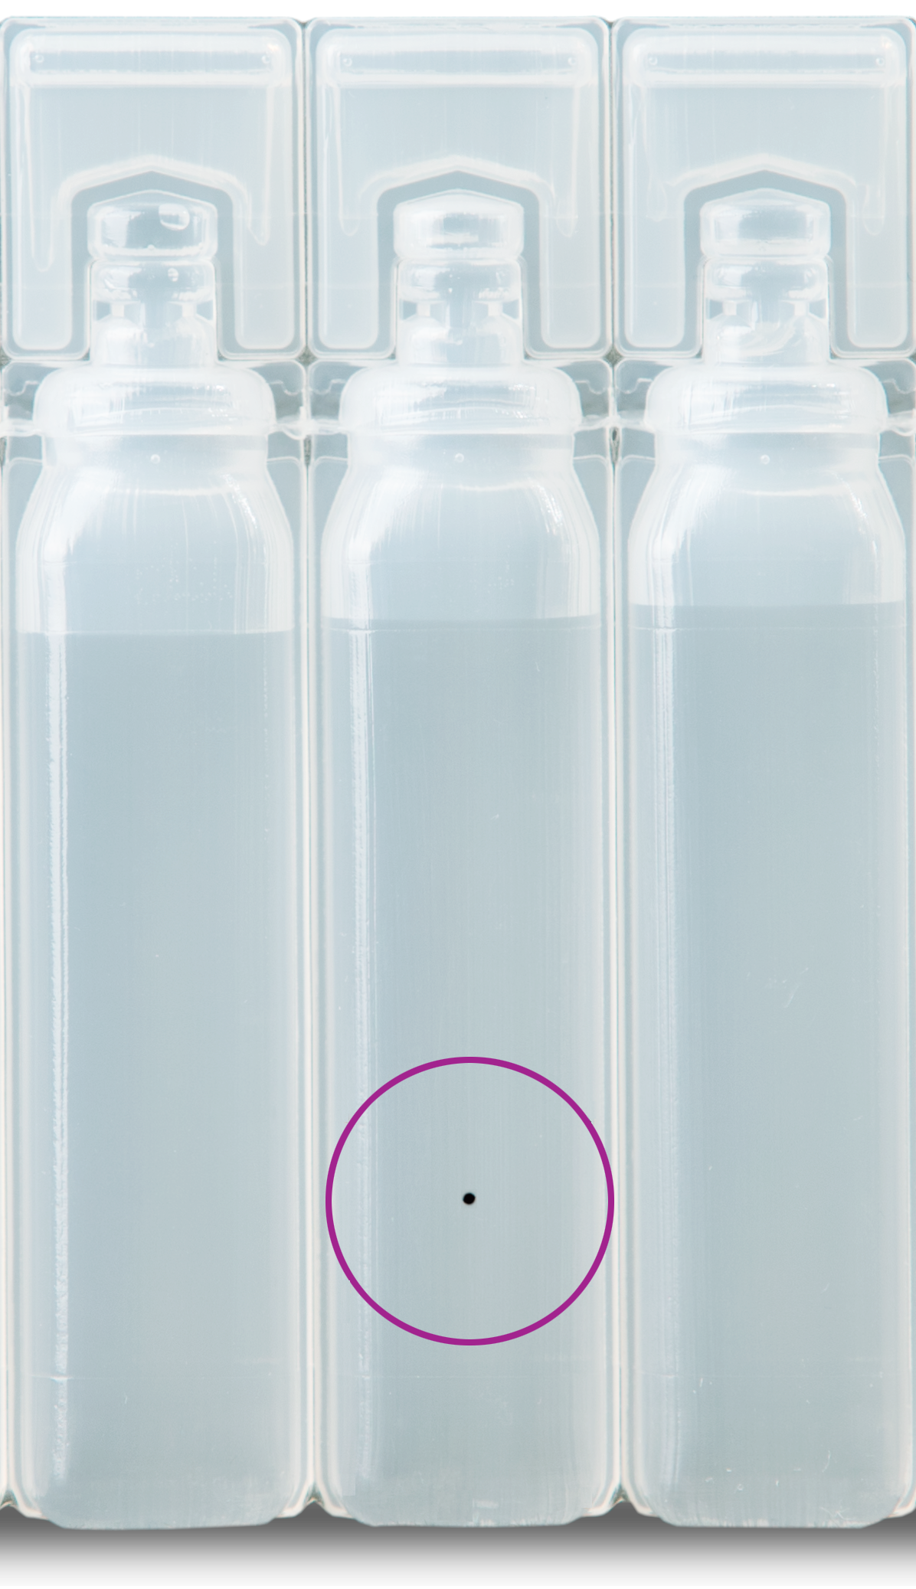
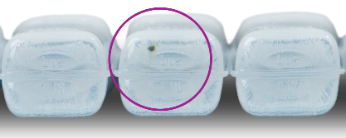
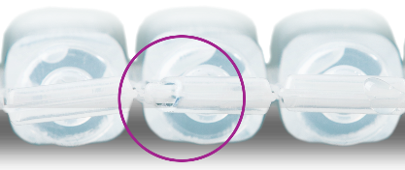
HEUFT spotter ^{II} BFS – Blow-Fill-Seal ampoule inspection machine
HEUFT spotter ^{II} BFS
All-around quality inspection of Blow-Fill-Seal ampoules based on the HEUFT SPECTRUM ^{II}.

Slide 4

HEUFT spotter ^{II} BFS – Blow-Fill-Seal ampoule inspection machine
BFS MACHINE
AUTOCLAVE
HEUFT spotter ^{II} BFS
LABELLER
PACKER
Line layout

Slide 5

HEUFT spotter ^{II} BFS – Blow-Fill-Seal ampoule inspection machine
Closure inspection
Cosmetic inspection
Product inspection
Base inspection
Inspection areas

Slide 6
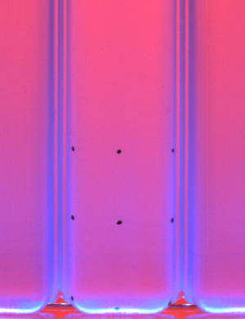
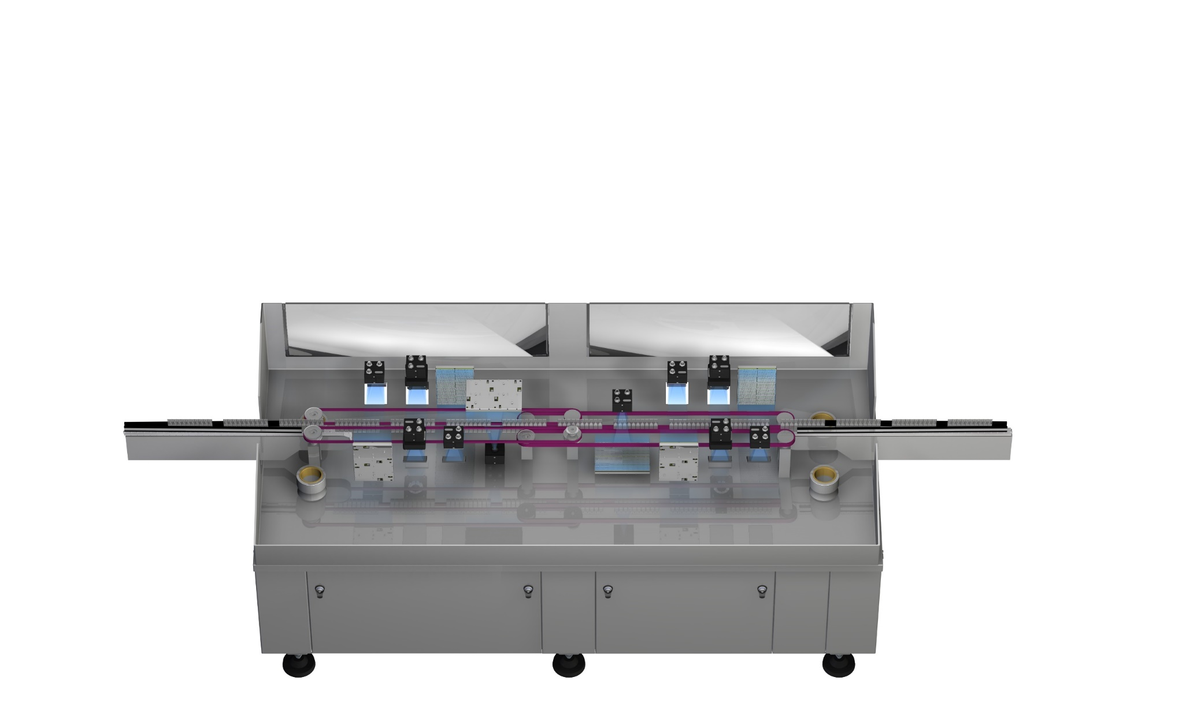
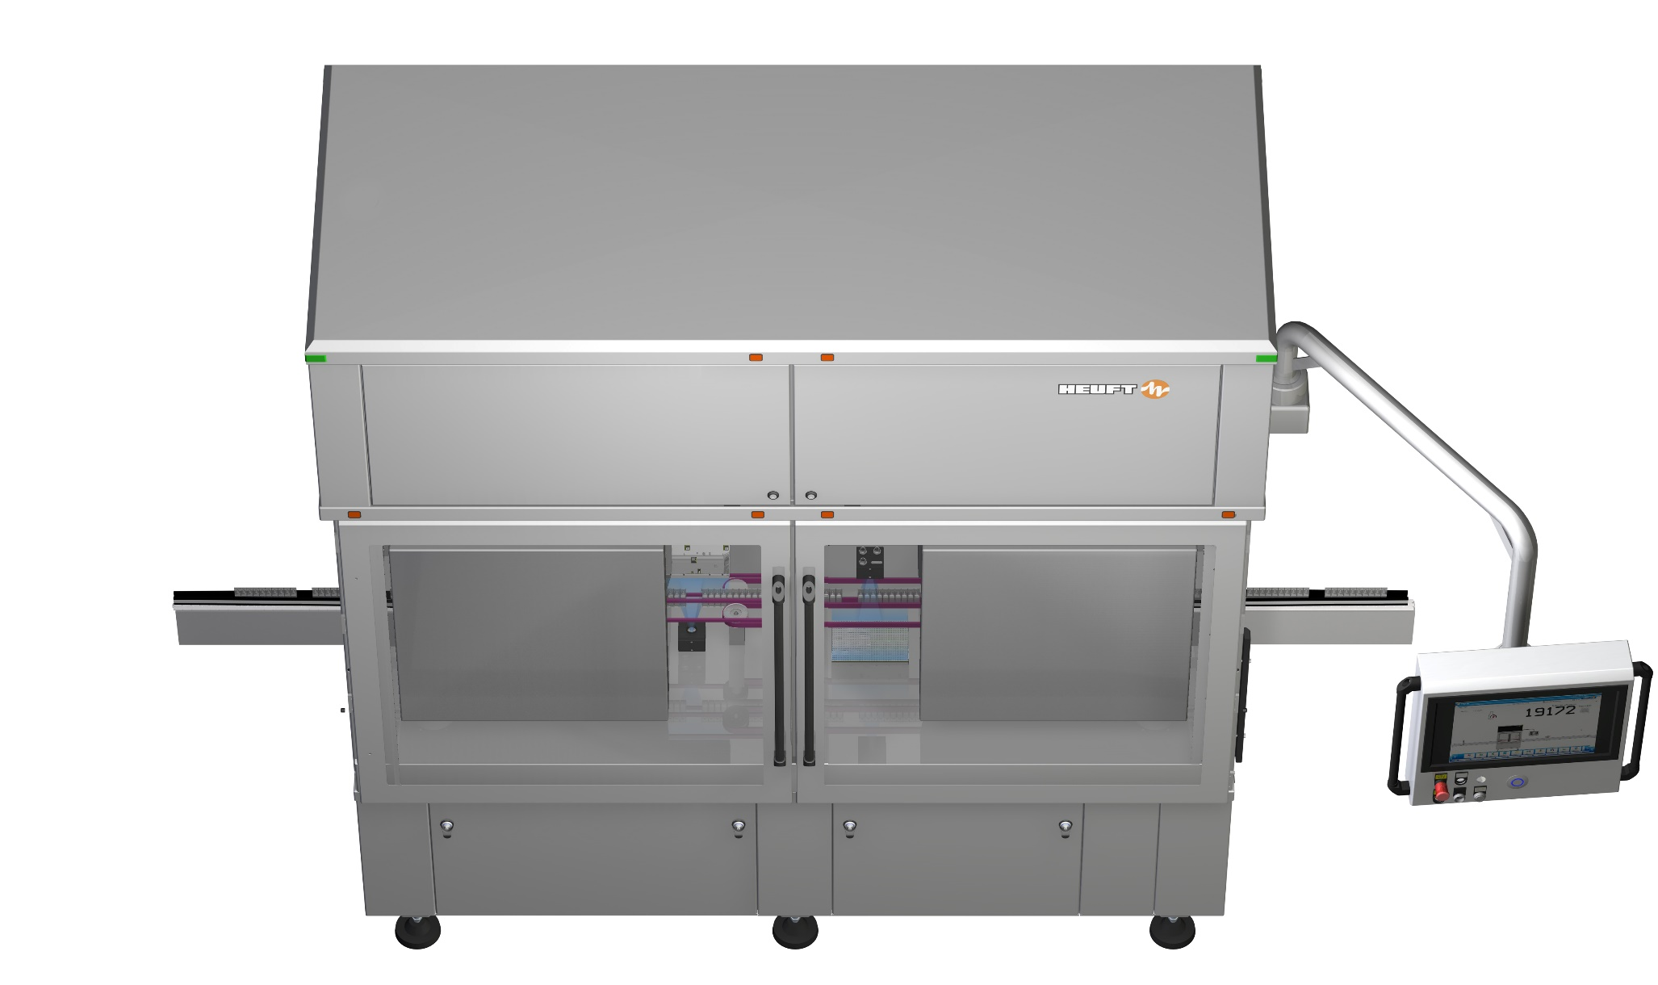
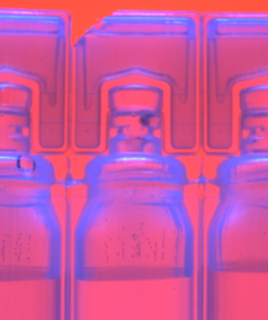
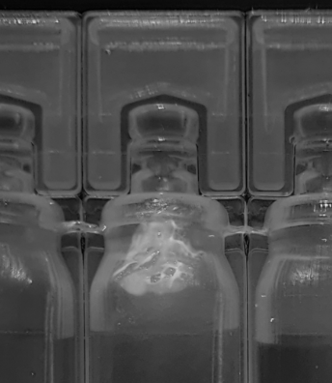
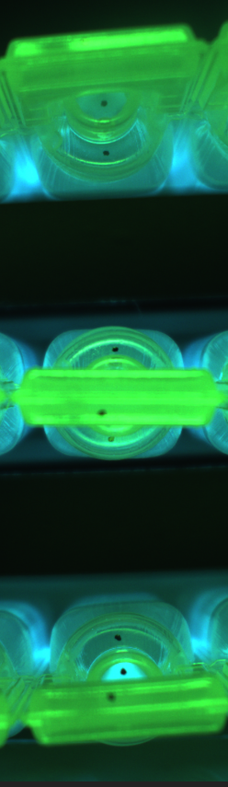
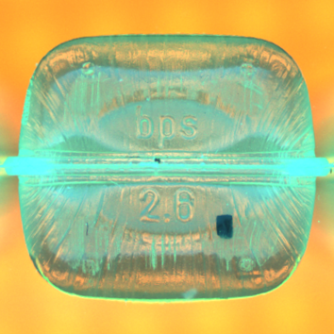
HEUFT spotter ^{II} BFS – Blow-Fill-Seal ampoule inspection machine

Slide 7
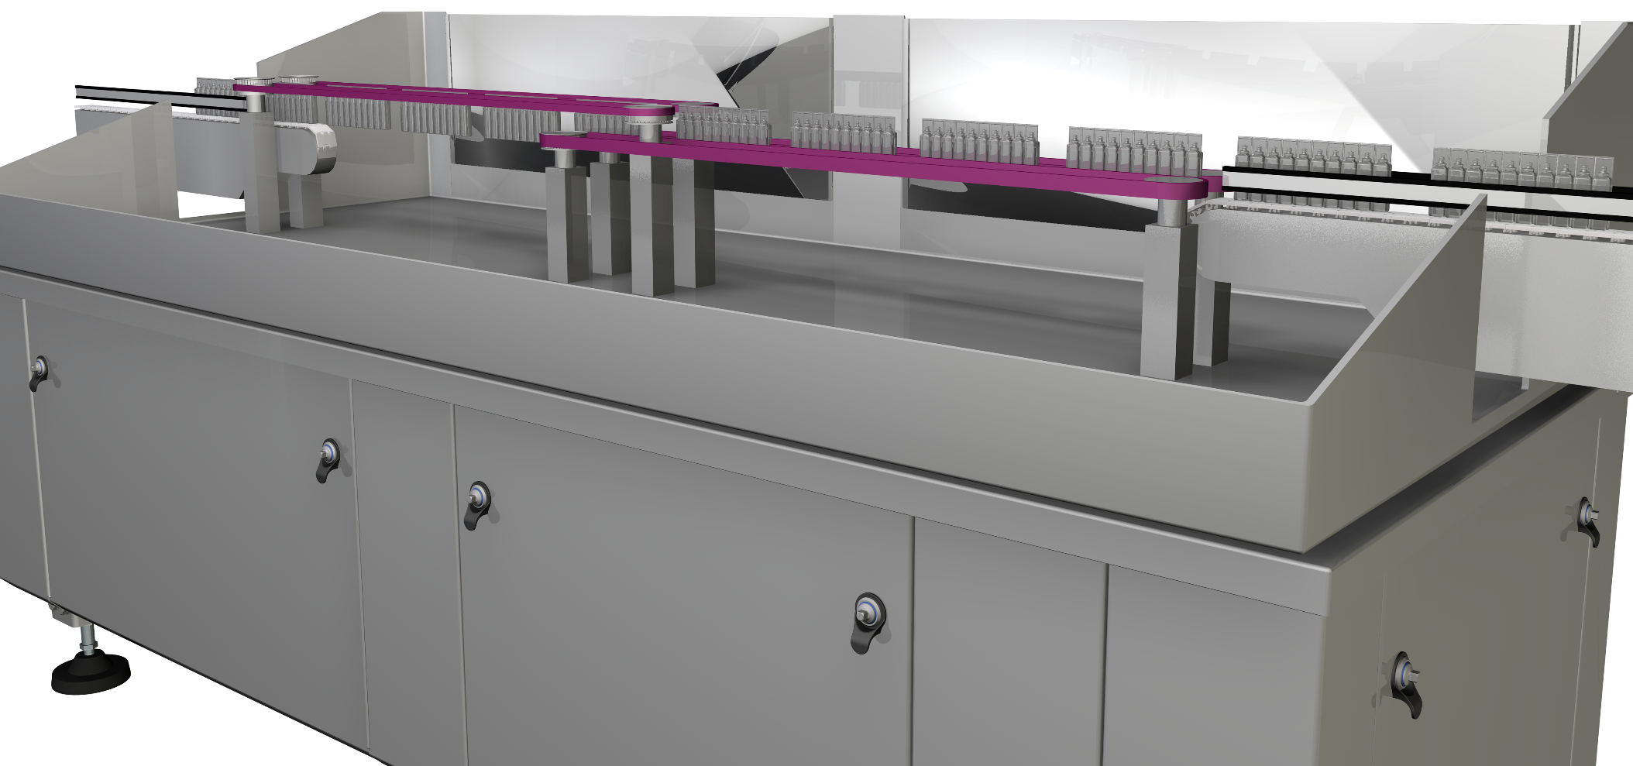
HEUFT spotter ^{II} BFS – Blow-Fill-Seal ampoule inspection machine
Moving direction
Transportation method

Slide 8
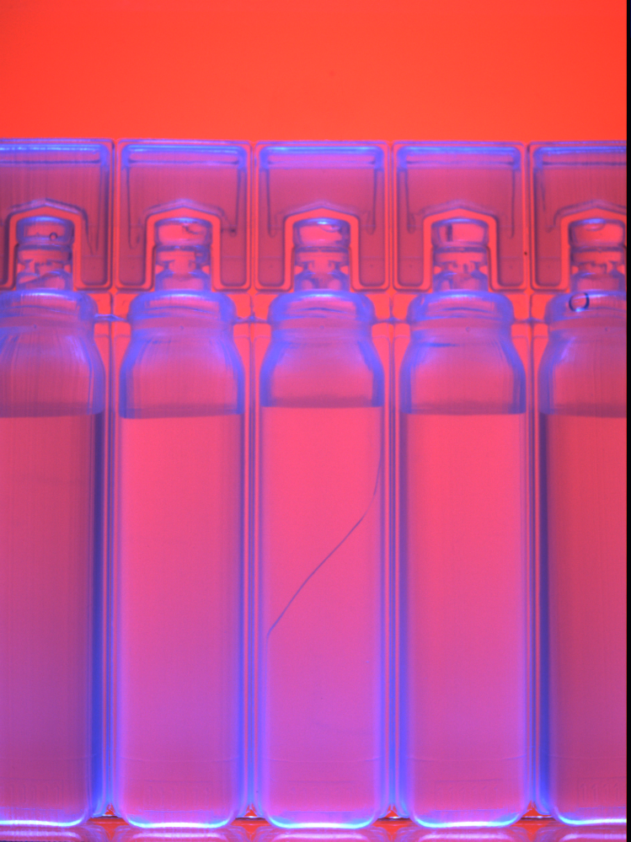
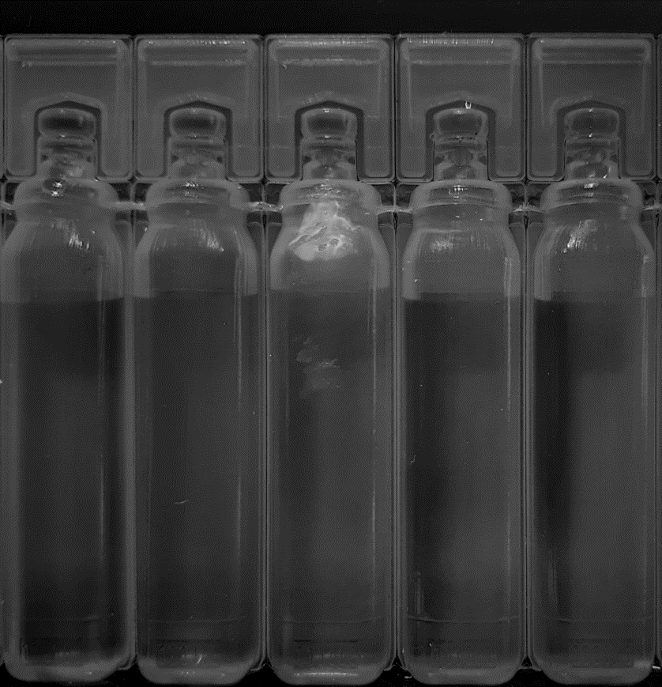
HEUFT spotter ^{II} BFS – Blow-Fill-Seal ampoule inspection machine
The sidewall inspection is divided into upper & lower sidewall inspection with multiple illumination principles
Illumination principle for the detection of classical faults
Special illumination principle for the detection of opaque greasy contamination
MCIP
(Multi Colour Image Processing)
Special illumination
Sidewall inspection

Slide 9
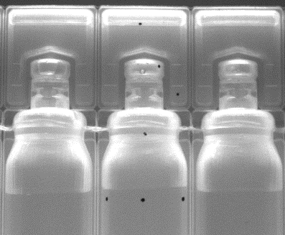

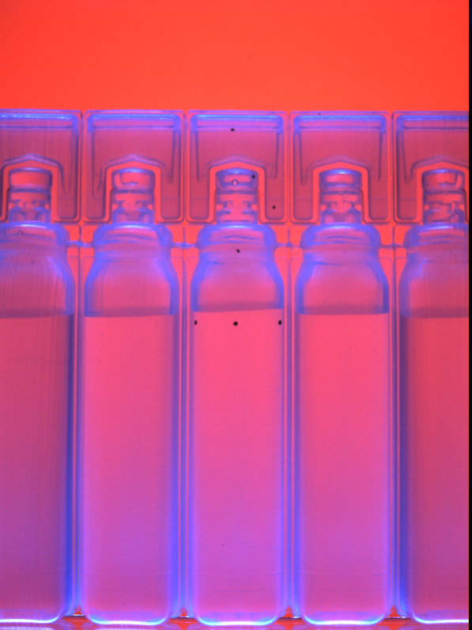
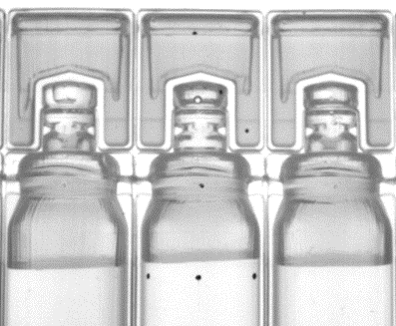
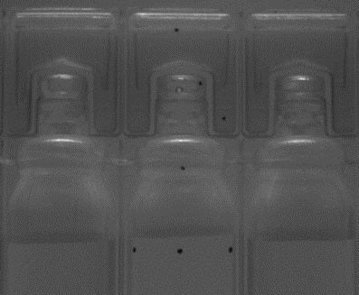
HEUFT spotter ^{II} BFS – Blow-Fill-Seal ampoule inspection machine
MCIP (Multi Colour Image Processing)
Advanced illumination set-up
Image subtraction method
Optimized evaluation image depending on fault category
3Mpx camera resolution
Illumination principle

Slide 10
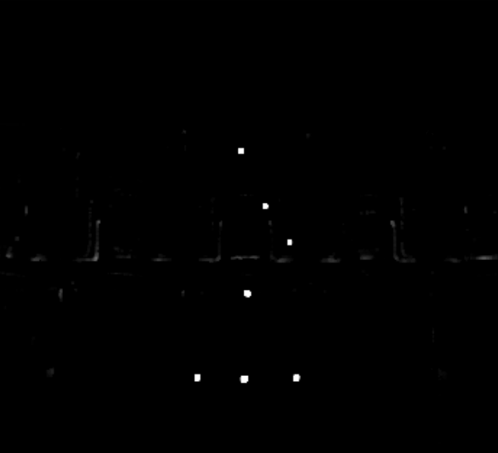
HEUFT spotter ^{II} BFS – Blow-Fill-Seal ampoule inspection machine
Characteristics image
Evaluation

Slide 11

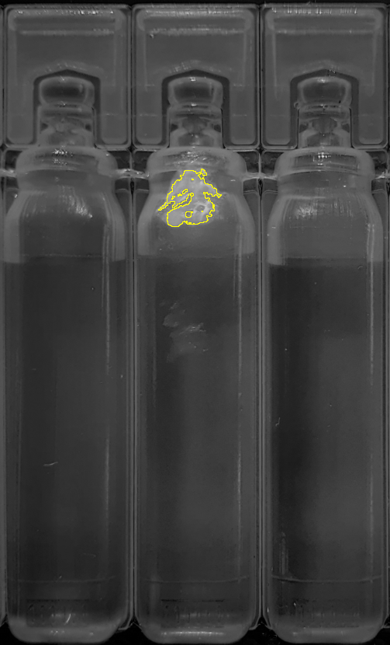
HEUFT spotter ^{II} BFS – Blow-Fill-Seal ampoule inspection machine
Special illumination
Detection of opaque greasy contamination
Illumination principle

Slide 12
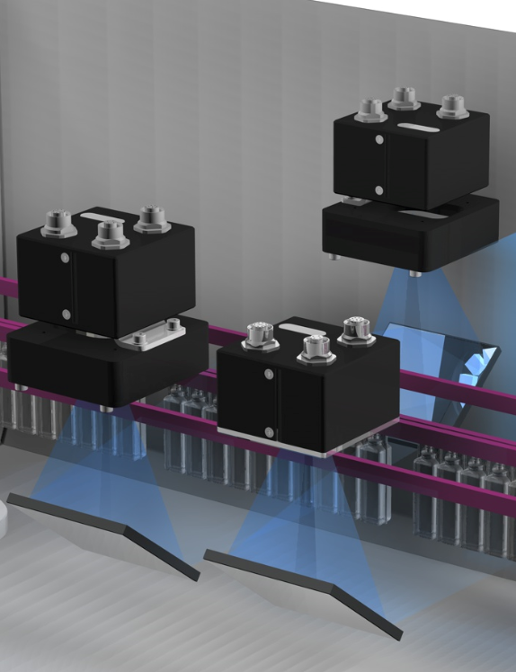
HEUFT spotter ^{II} BFS – Blow-Fill-Seal ampoule inspection machine
Upper sidewall inspection
Closure inspection
Cosmetic defect detection
Particle detection
Fill-level detection
Upper sidewall inspection

Slide 13

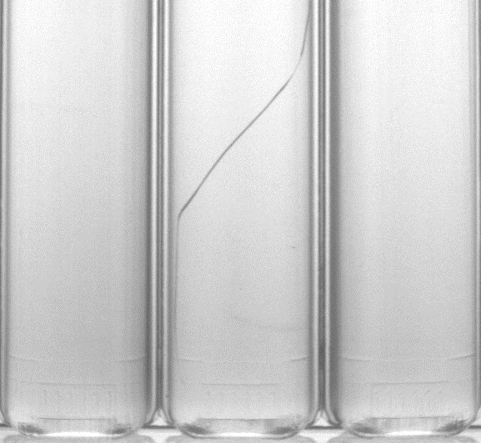
HEUFT spotter ^{II} BFS – Blow-Fill-Seal ampoule inspection machine
Lower sidewall inspection
Cosmetic defect detection
Particle detection
Discoloration detection
Lower sidewall inspection

Slide 14




HEUFT spotter ^{II} BFS – Blow-Fill-Seal ampoule inspection machine
Body damage
scratch
Fill-level
underfilled / overfilled
Particle
filter material
Black spots
inclusions
Examples of various defects

Slide 15




HEUFT spotter ^{II} BFS – Blow-Fill-Seal ampoule inspection machine
Forming defects
interrupted connector
Excess material
Lack of material
Discolorations
product
Body damage
pinch
Examples of various defects

Slide 16
HEUFT spotter ^{II} BFS – Blow-Fill-Seal ampoule inspection machine
Base inspection
Cosmetic defect detection
Particle detection
Base inspection

Slide 17
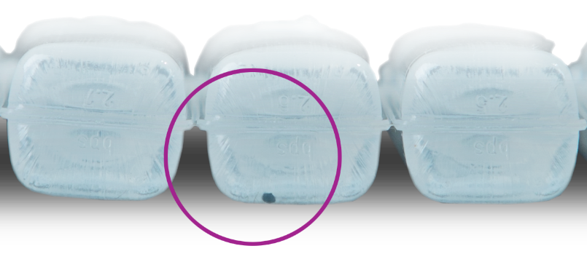
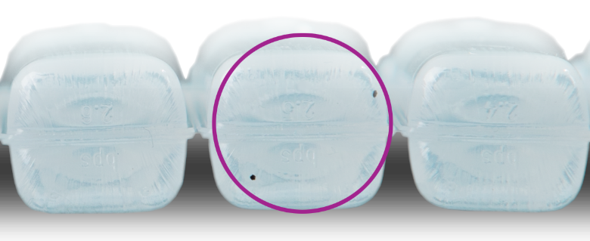
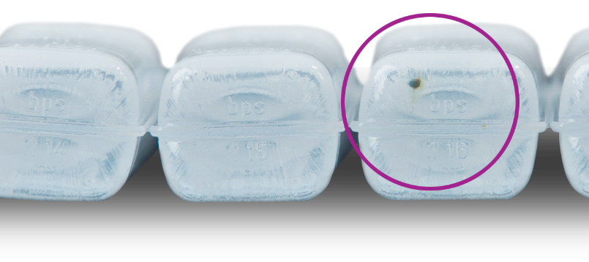
HEUFT spotter ^{II} BFS – Blow-Fill-Seal ampoule inspection machine
Particle
rubber particle
Black spots
inclusions
Particle
metal particle
Examples of various defects

Slide 18
HEUFT spotter ^{II} BFS – Blow-Fill-Seal ampoule inspection machine
Top-down inspection
Optomechanical design to eliminate blind spots
Closure inspection
Cosmetic defect detection
Top-down inspection

Slide 19
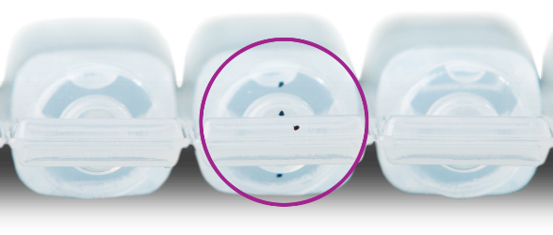

HEUFT spotter ^{II} BFS – Blow-Fill-Seal ampoule inspection machine
Black spots
inclusions
Body damage
damaged closure
Examples of various defects

Slide 20
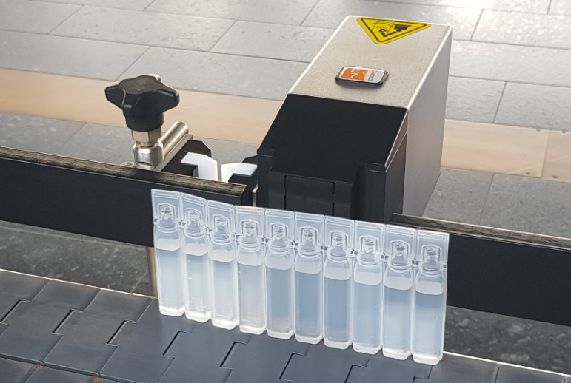
HEUFT spotter ^{II} BFS – Blow-Fill-Seal ampoule inspection machine
Various automatic rejection systems are available for the rejection of incorrect products.
Rejection

Slide 21
HEUFT spotter ^{II} BFS – Blow-Fill-Seal ampoule inspection machine
Thank you…
We are glad to get in contact with you!
www.heuft.com
pharma@heuft.com

