Slide 1
HEUFT spotter ^{II} BFS – Blow-Fill-Seal bottle inspection machine
Sebastian Mayer – Product Manager Pharma & Healthcare
HEUFT spotter ^{II} BFS – Blow-Fill-Seal bottle inspection machine

Slide 2

HEUFT spotter ^{II} BFS – Blow-Fill-Seal bottle inspection machine
GMP - Annex 1 Manufacture of Sterile Medicinal Products
Finishing of sterile products
“(…) Containers closed by fusion, e.g. Form-Fill-Seal Small Volume Parenteral (SVP) & Large Volume Parenteral (LVP) bags, glass or plastic ampoules, should be subject to 100% integrity testing. (…)”

Slide 3
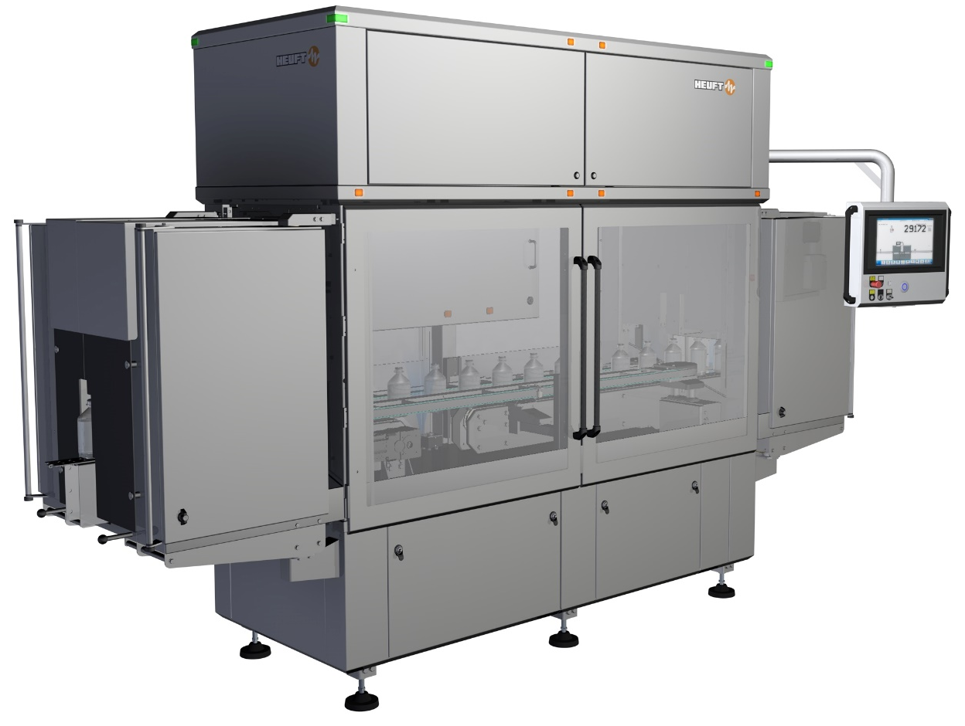

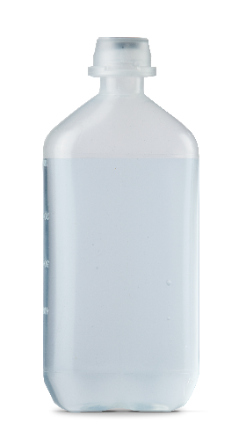
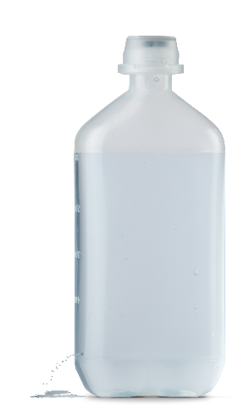
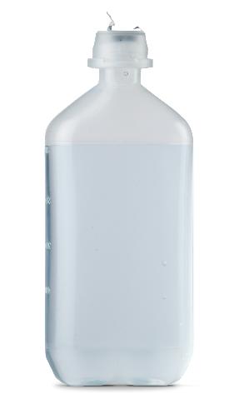
HEUFT spotter ^{II} BFS – Blow-Fill-Seal bottle inspection machine
HEUFT spotter ^{II} BFS
All-around quality inspection of Blow-Fill-Seal bottles based on the HEUFT SPECTRUM ^{II}.
cap defective
black spots
particle
leaking bottle

Slide 4

HEUFT spotter ^{II} BFS – Blow-Fill-Seal bottle inspection machine
BFS MACHINE
AUTOCLAVE
HEUFT spotter ^{II} BFS
LABELLER
PACKER
Line layout

Slide 5

HEUFT spotter ^{II} BFS – Blow-Fill-Seal bottle inspection machine
Cap inspection
Cosmetic inspection
Product inspection
Base inspection
Inspection areas

Slide 6
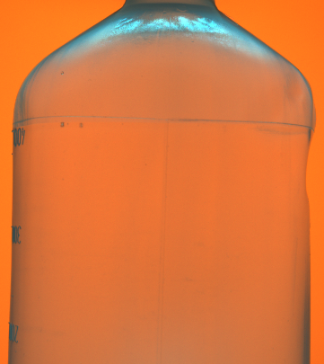
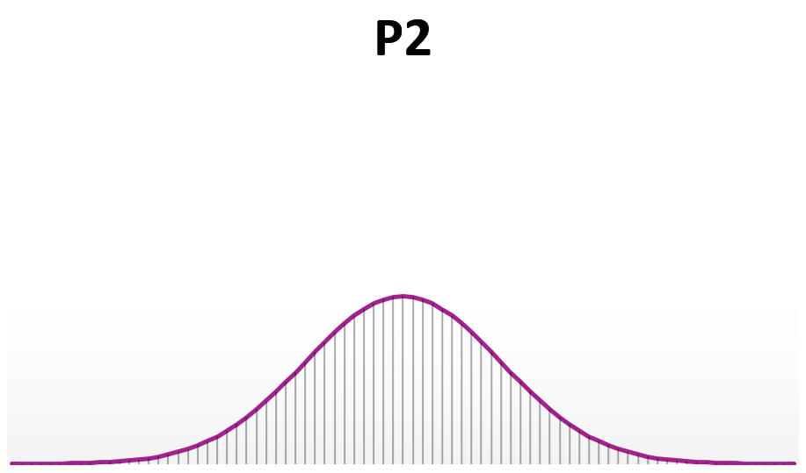
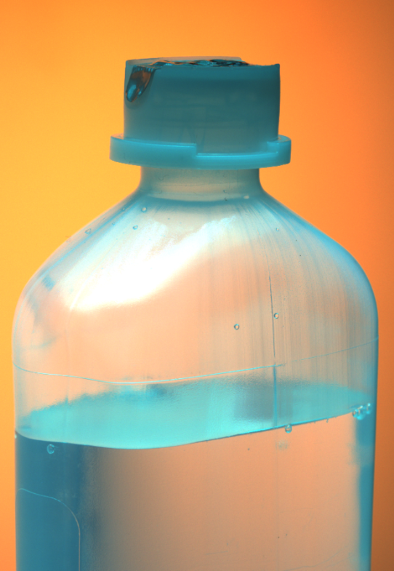
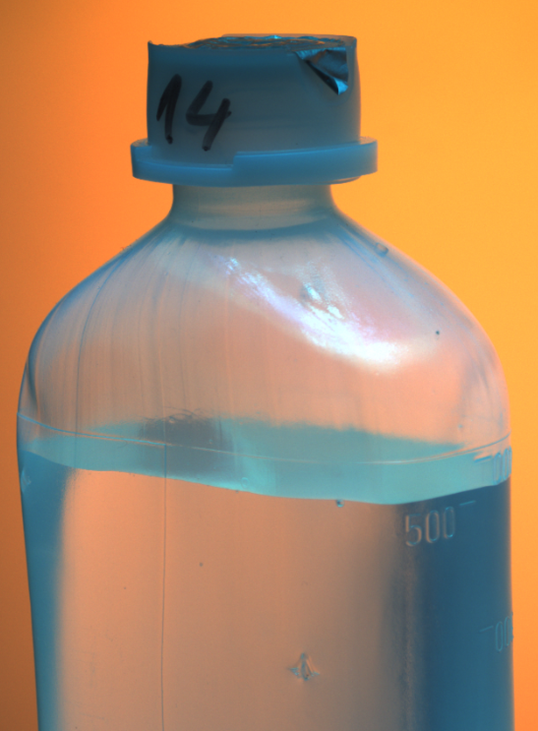
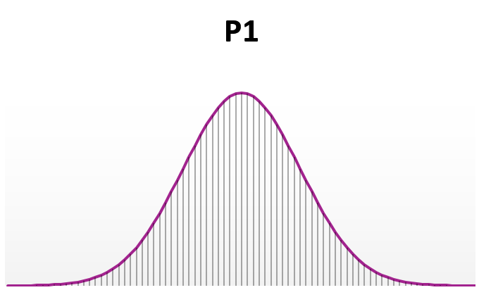
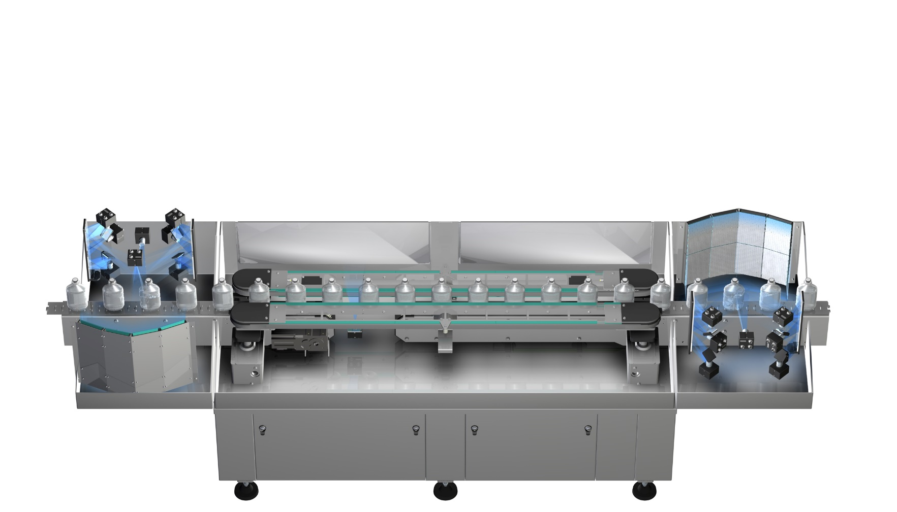
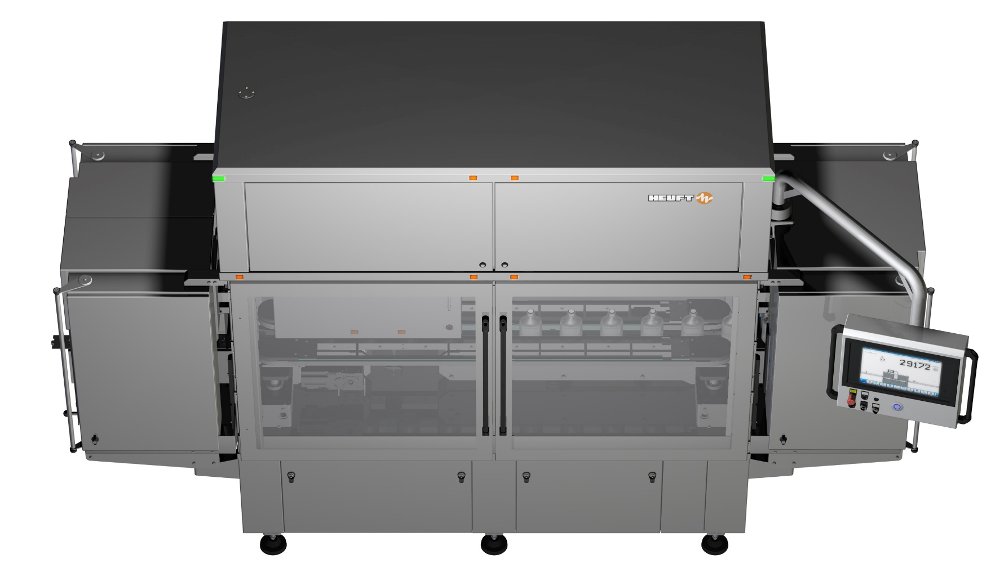
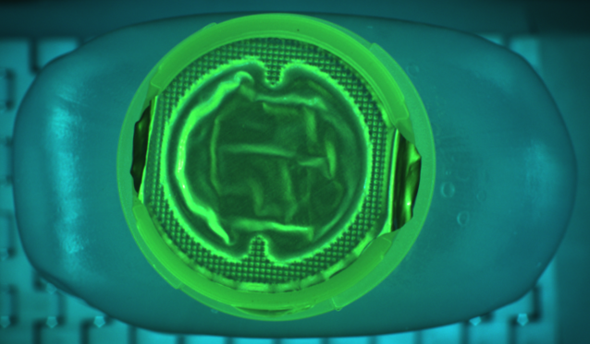
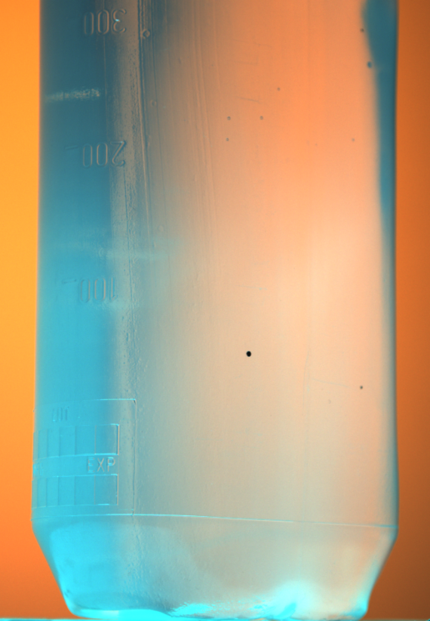
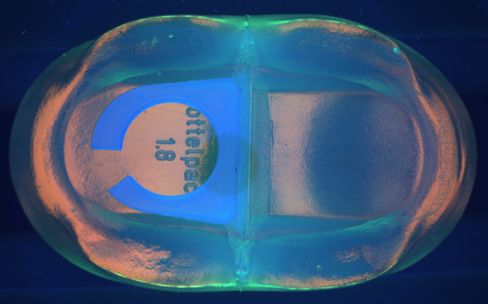

HEUFT spotter ^{II} BFS – Blow-Fill-Seal bottle inspection machine
ΔP

Slide 7
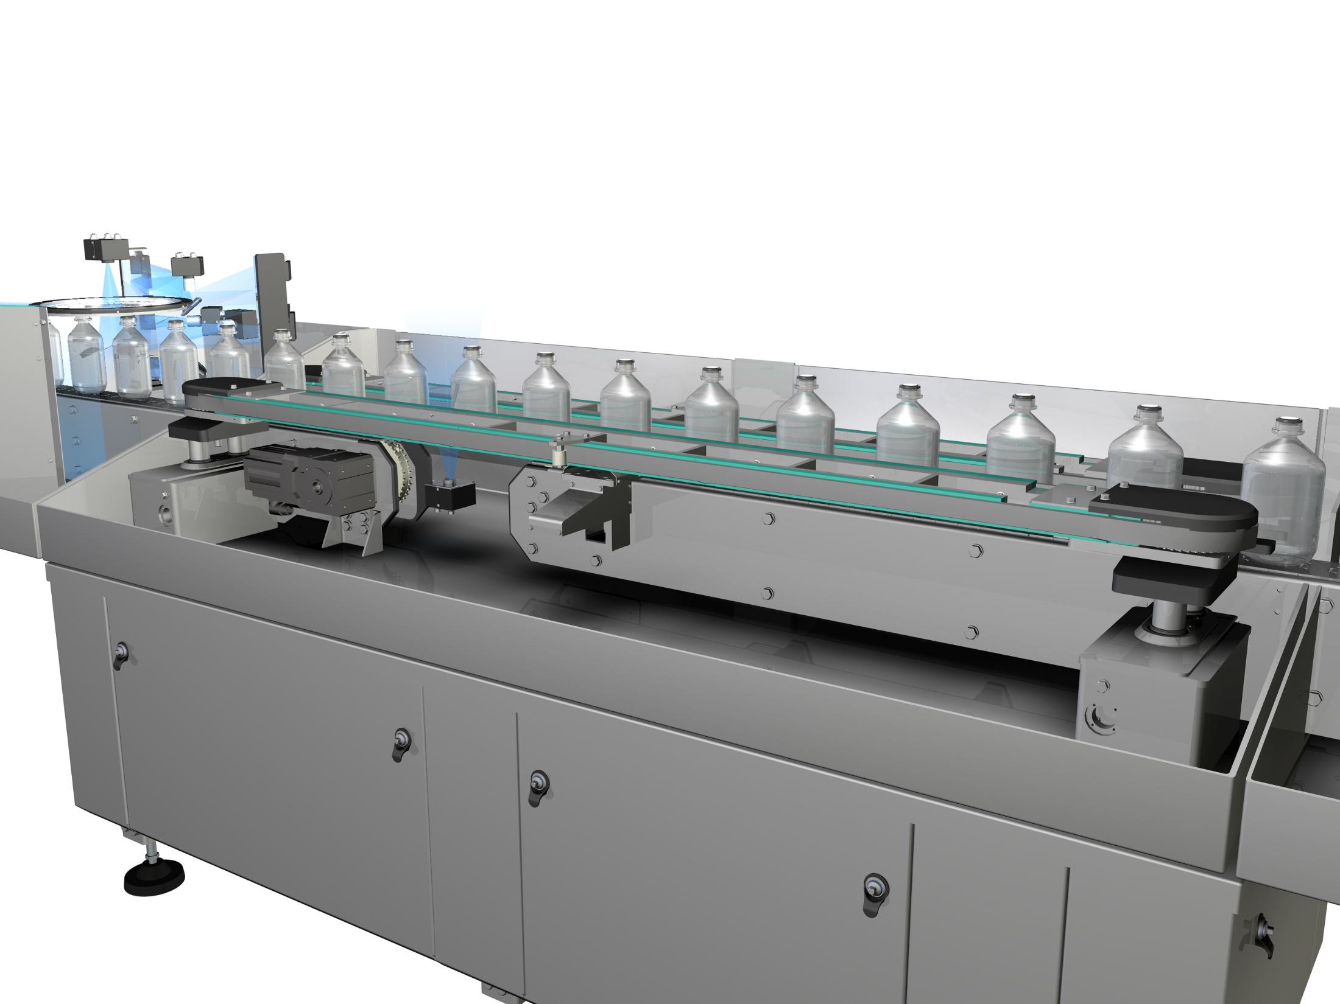
HEUFT spotter ^{II} BFS – Blow-Fill-Seal bottle inspection machine
Moving direction
Transportation method

Slide 8
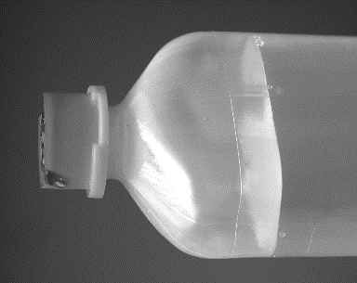

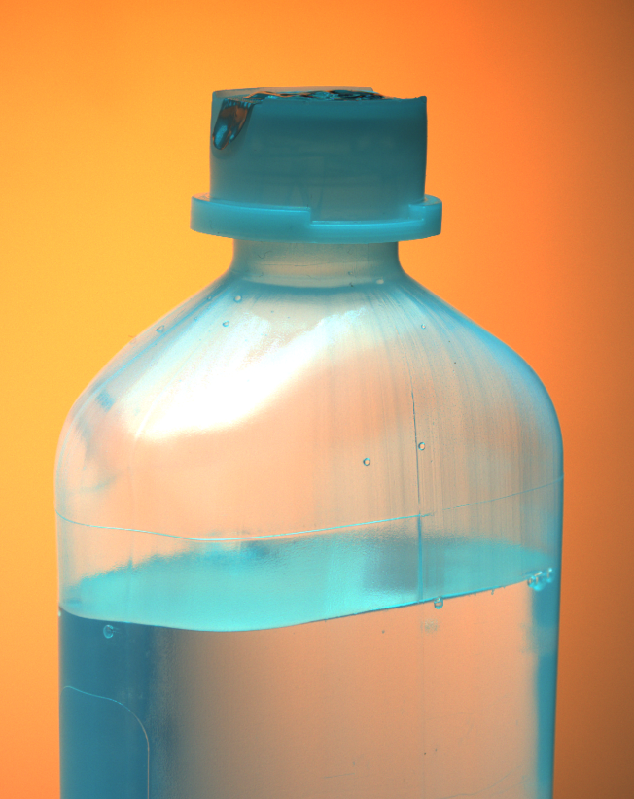
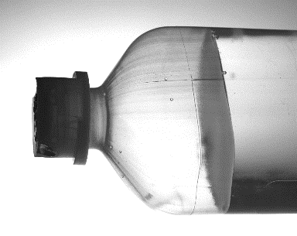
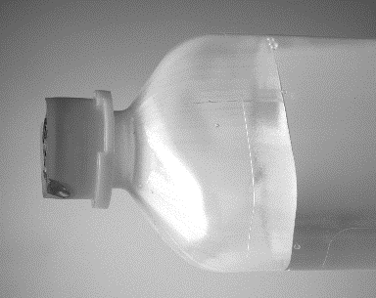
HEUFT spotter ^{II} BFS – Blow-Fill-Seal bottle inspection machine
MCIP (Multi Colour Image Processing)
Advanced illumination set-up
Image subtraction method
Optimized evaluation image depending on fault category
3Mpx camera resolution
Illumination principle

Slide 9
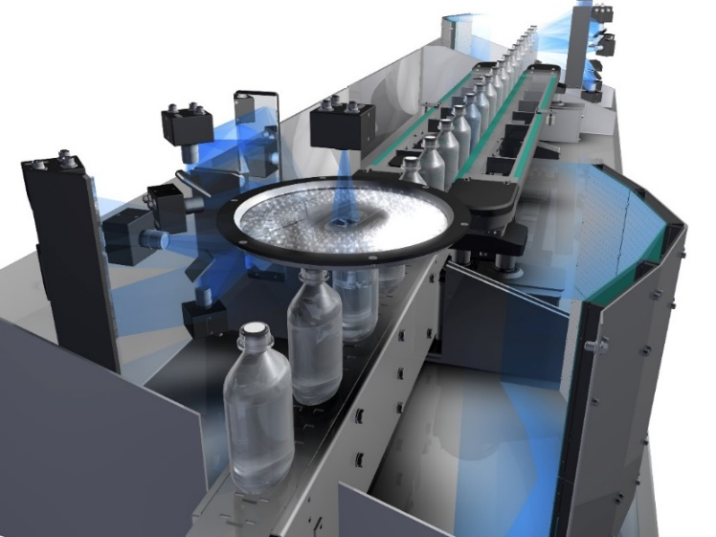
HEUFT spotter ^{II} BFS – Blow-Fill-Seal bottle inspection machine
Upper sidewall inspection
  Closure inspection
  Cosmetic defect detection
  Particle detection
Upper sidewall front view
  Fill-level detection
  Cosmetic defect detection
  Particle detection
Lower sidewall inspection
  Cosmetic defect detection
  Particle detection
Sidewall inspection

Slide 10
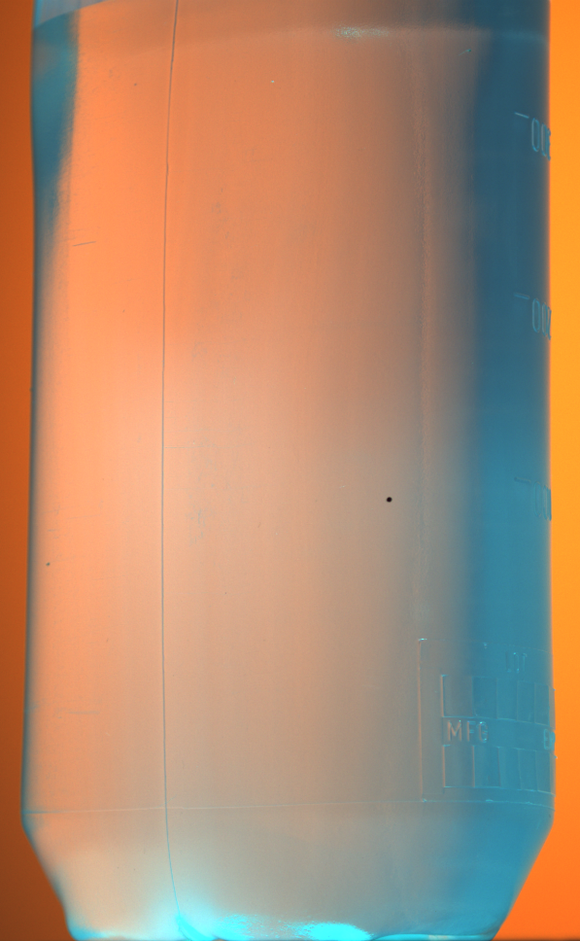
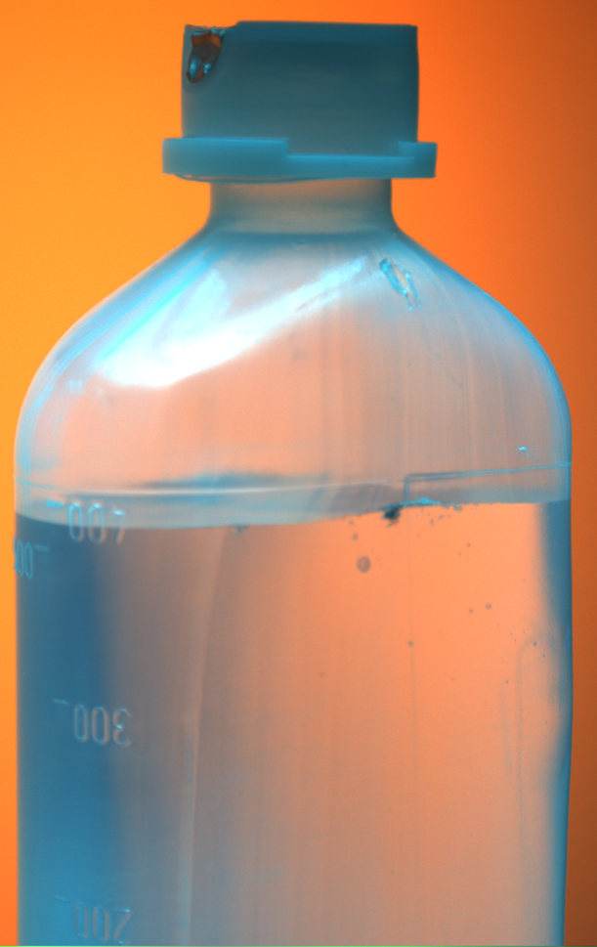
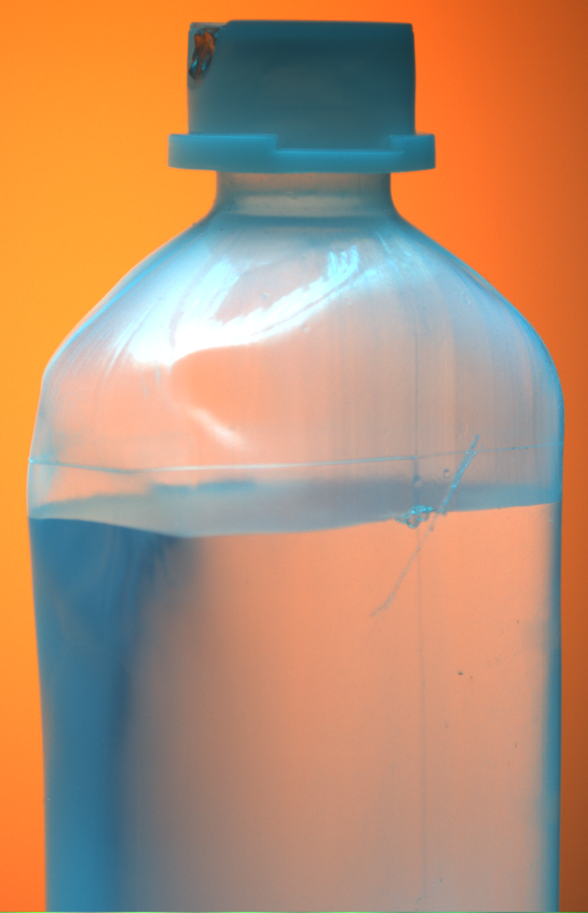
HEUFT spotter ^{II} BFS – Blow-Fill-Seal bottle inspection machine
Black spot
inclusion
Particle
filter material
Body damage
scratch
Example of various defects

Slide 11
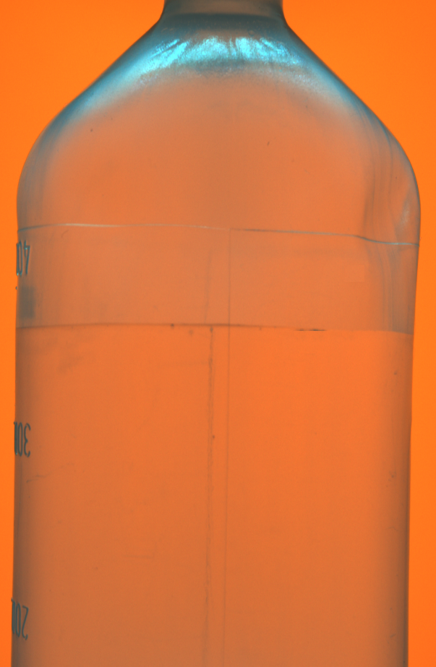
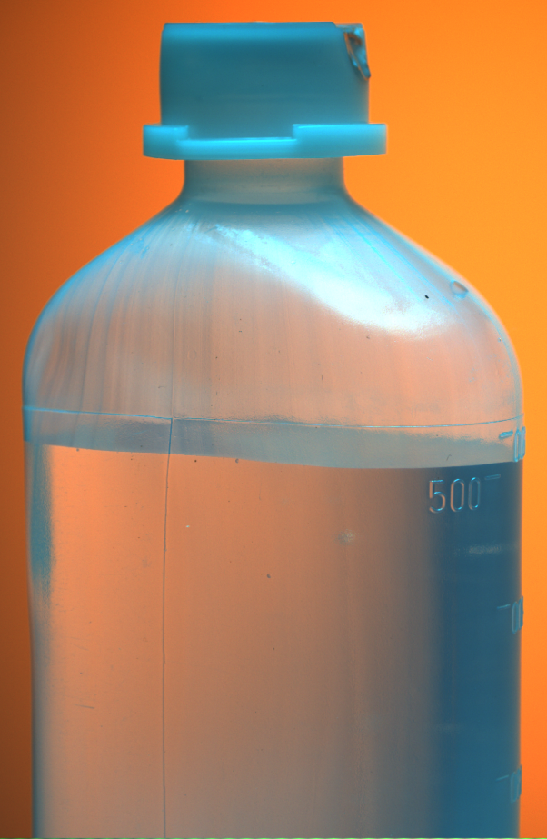
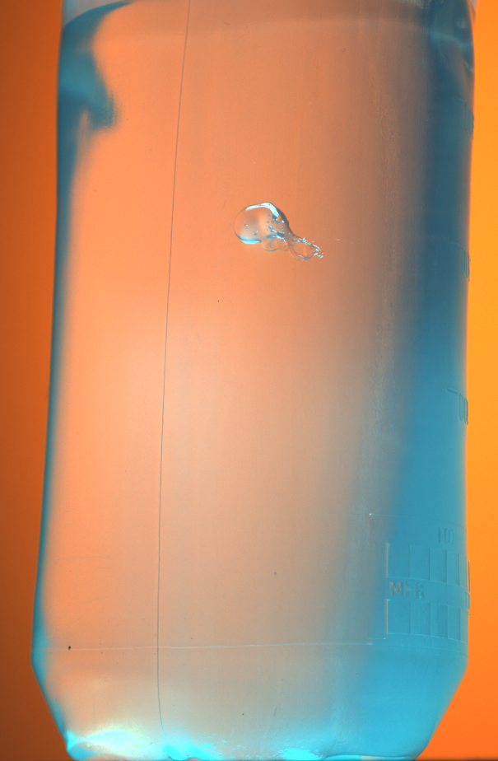
HEUFT spotter ^{II} BFS – Blow-Fill-Seal bottle inspection machine
Fill-level
Underfilled
Black spot
inlcusion
Excess material
Example of various defects

Slide 12

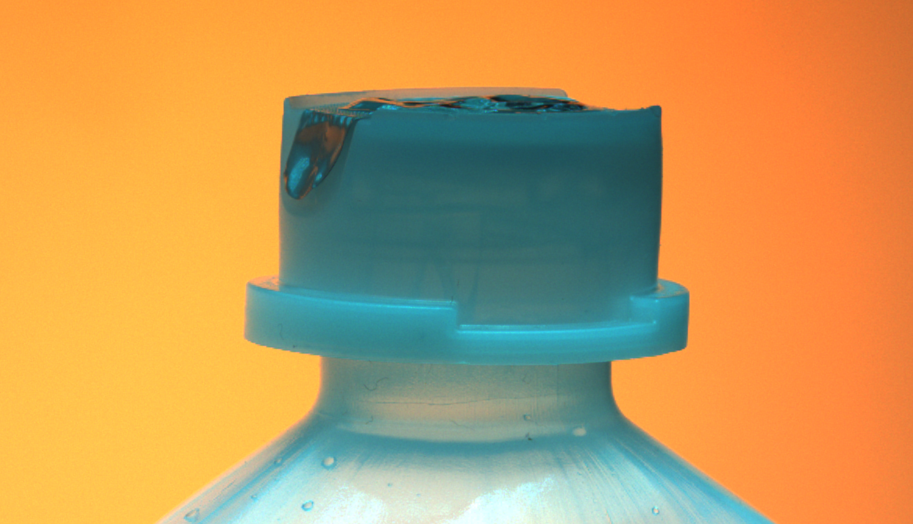
HEUFT spotter ^{II} BFS – Blow-Fill-Seal bottle inspection machine
360° cap inspection
Four inspection images in total
Cap inspection

Slide 13
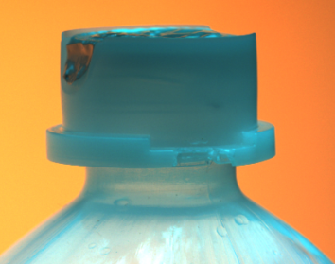
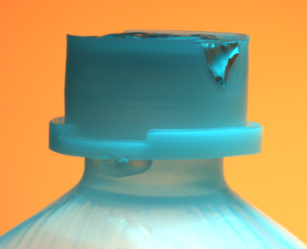
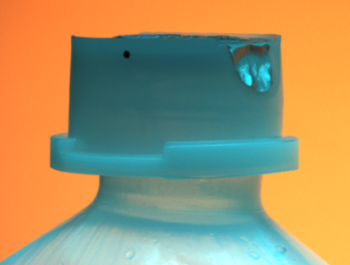
HEUFT spotter ^{II} BFS – Blow-Fill-Seal bottle inspection machine
Lack of material
sealing ring
Excess material
sealing ring
Black spot
inclusion
Example of various defects

Slide 14
HEUFT spotter ^{II} BFS – Blow-Fill-Seal bottle inspection machine
Presence
Alignment
Contamination
Damage
Top-down inspection

Slide 15
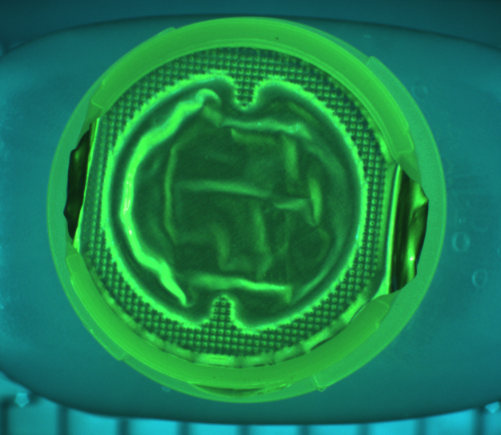
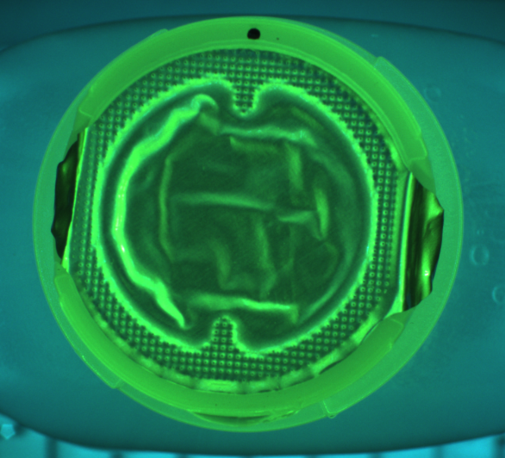
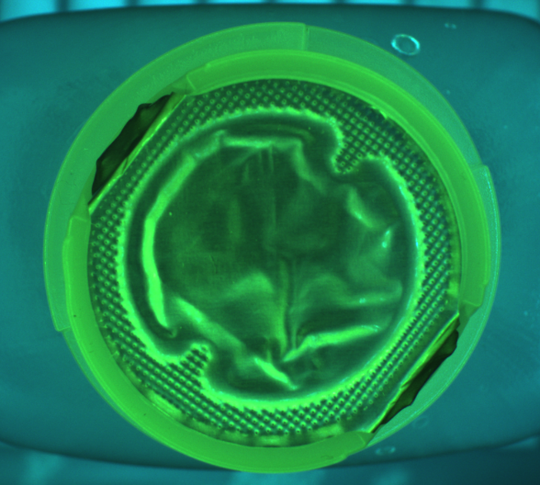
HEUFT spotter ^{II} BFS – Blow-Fill-Seal bottle inspection machine
Closure defect
flagging sealing foil
Black spot
inclusion
Closure defect
wrong closure angle
Example of various defects

Slide 16
HEUFT spotter ^{II} BFS – Blow-Fill-Seal bottle inspection machine
The belt-drive presents the containers to the base inspection.
Base inspection

Slide 17
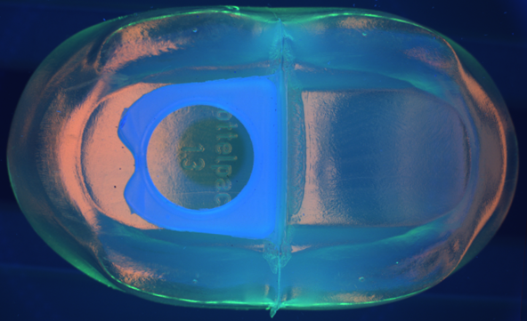
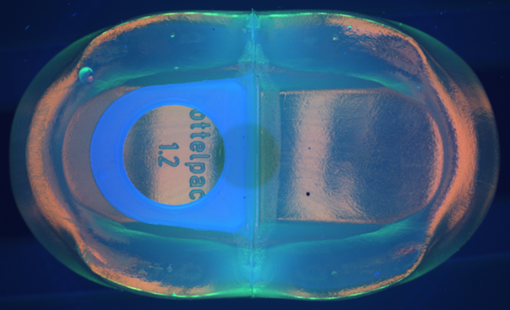
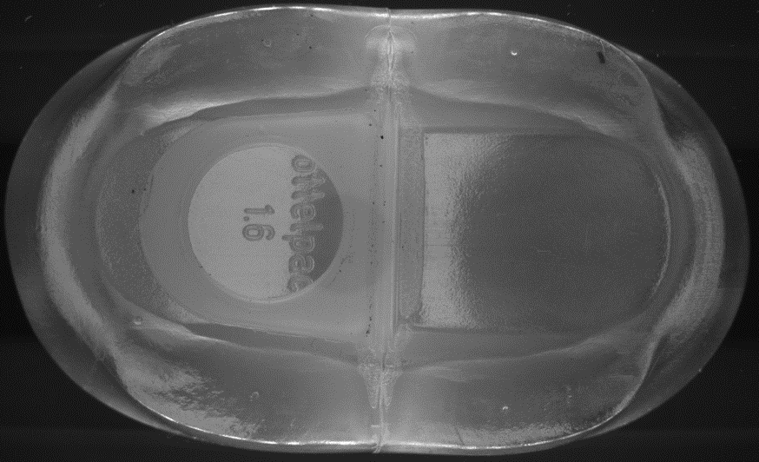
HEUFT spotter ^{II} BFS – Blow-Fill-Seal bottle inspection machine
Forming defect
hanger deformed
Black spot
inclusion
Particle
metal particle
Example of various defects

Slide 18

HEUFT spotter ^{II} BFS – Blow-Fill-Seal bottle inspection machine
ΔP
The containers are guided between two belts that apply a defined lateral force
Inside the belt drive two pressure sensor are installed
ΔP is calculated from the measured infeed (P1) and outfeed (P2) pressure
Leakage detection – Pressure decay method

Slide 19
HEUFT spotter ^{II} BFS – Blow-Fill-Seal bottle inspection machine
The principle of the pressure decay method is based on the same principle as the vacuum decay method or the manual inspection method
Capable for high speed lines (12,000 c/h)
Independent from the electrical conductivity of the product
No format parts required
Very little maintenance required
Leakage detection

Slide 20
Blow-Fill-Seal (BFS) bottle inspection – container integrity and cosmetic defect detection
Infeed sensor
Outfeed sensor
P1
P2
Tight container
Pressure signal
Leaking container
Pressure
generation
Process time
Pressure curve

Slide 21
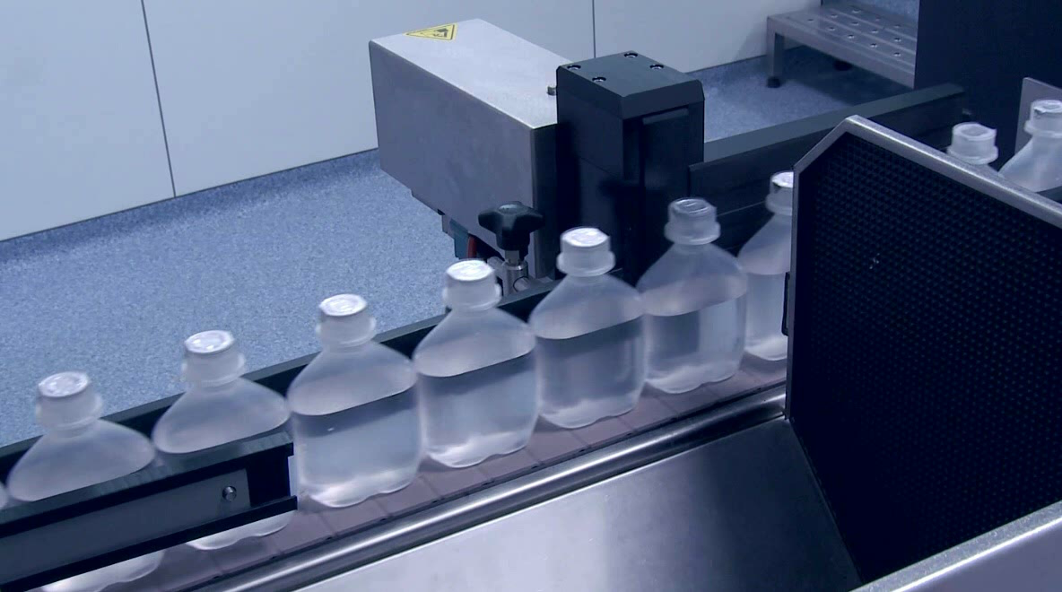
Blow-Fill-Seal (BFS) bottle inspection – container integrity and cosmetic defect detection
Various automatic rejection systems are available for the rejection of incorrect products.
Rejection

Slide 22
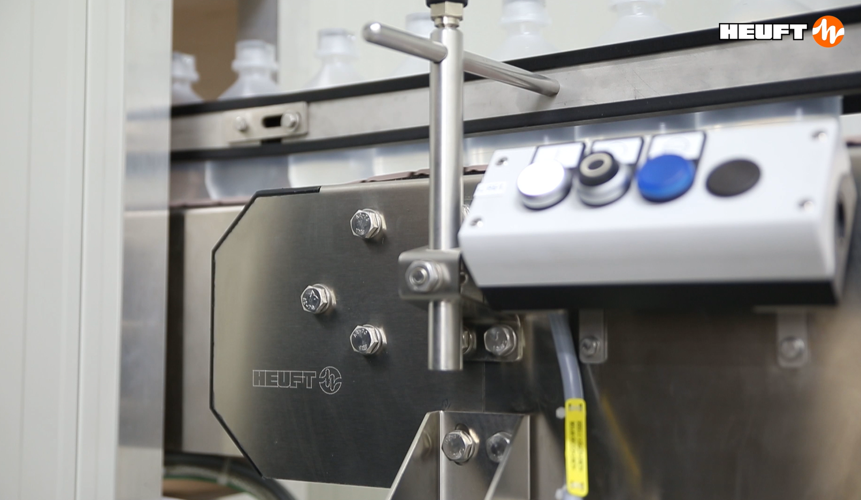
Blow-Fill-Seal (BFS) bottle inspection – container integrity and cosmetic defect detection
Conveyor mechanics & conveyor control from HEUFT!
Conveyor & Conveyor control

Slide 23
Blow-Fill-Seal (BFS) bottle inspection – container integrity and cosmetic defect detection
Thank you…
We are glad to get in contact with you!
www.heuft.com
pharma@heuft.com

