Slide 2
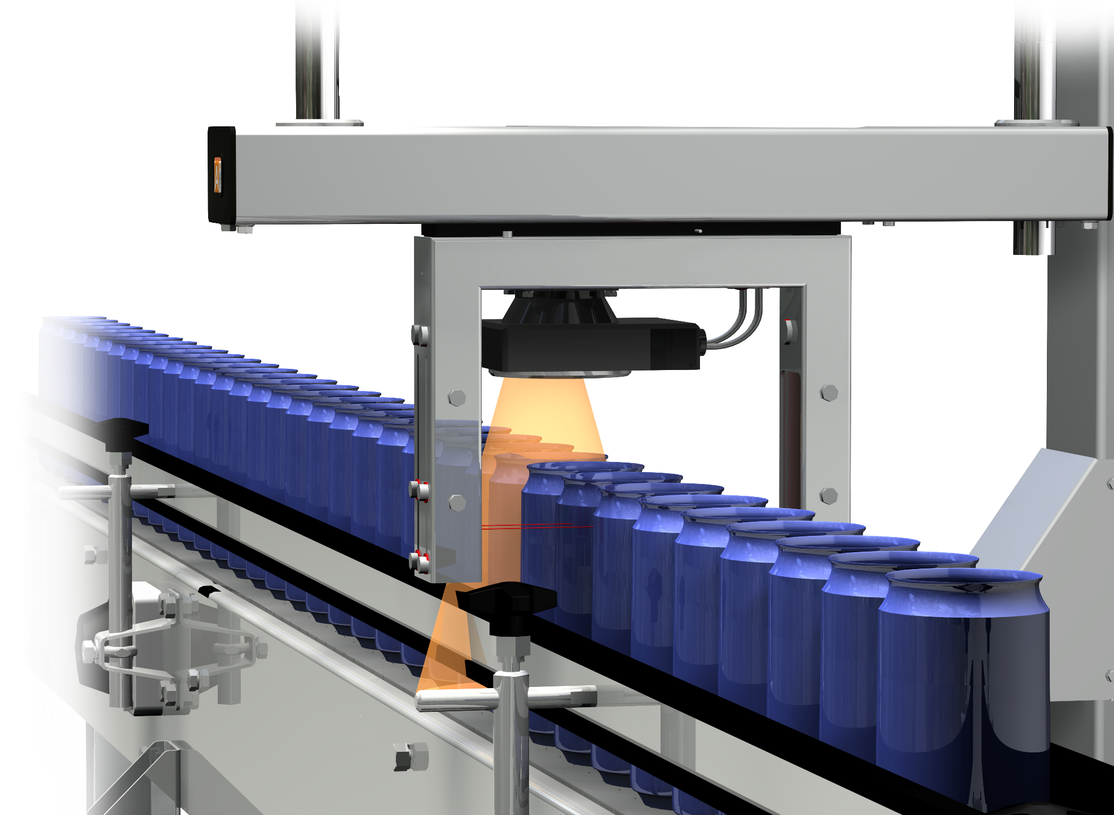
All-around solutions for the canning line
HEUFT CAN INSPECTION

Slide 3
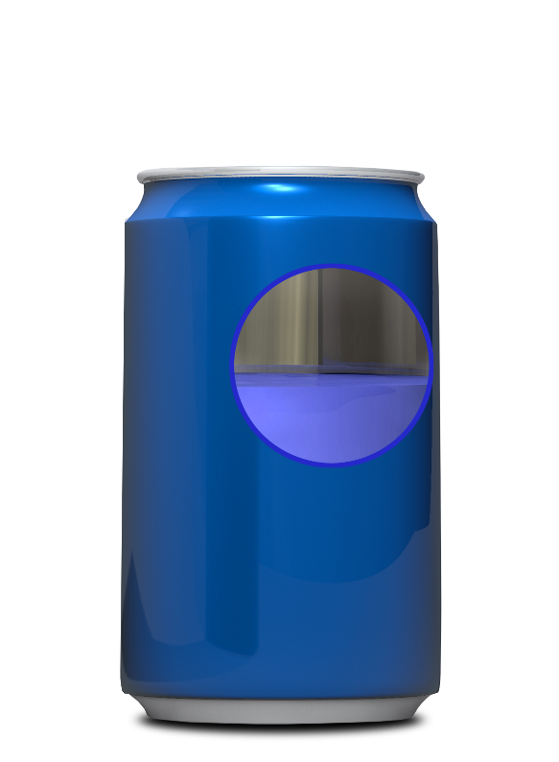
CAN INSPECTION
Empty cans
Filled cans
Dirt / foreign objects
Dents
Flange integrity
Code inspection
Fill level check
Pressure- / leakage check
Code inspection
foreign object detection with unique pulsed X-rays
HEUFT solutions for the can filling line

Slide 4
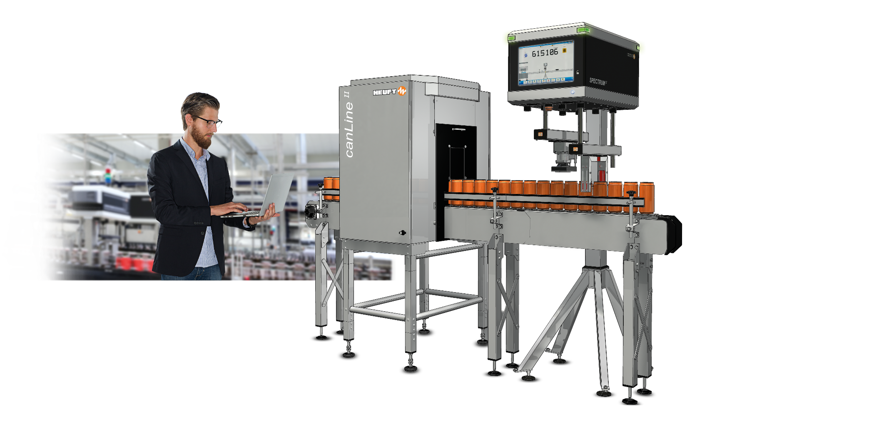
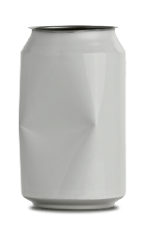
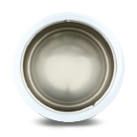
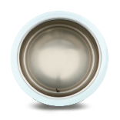
EMPTY CAN INSPECTION
An empty can inspection based on the HEUFT SPECTRUM ^{II} for simply more product safety and productivity.
HEUFT canLine ^{II}
Notes:
4

Slide 5
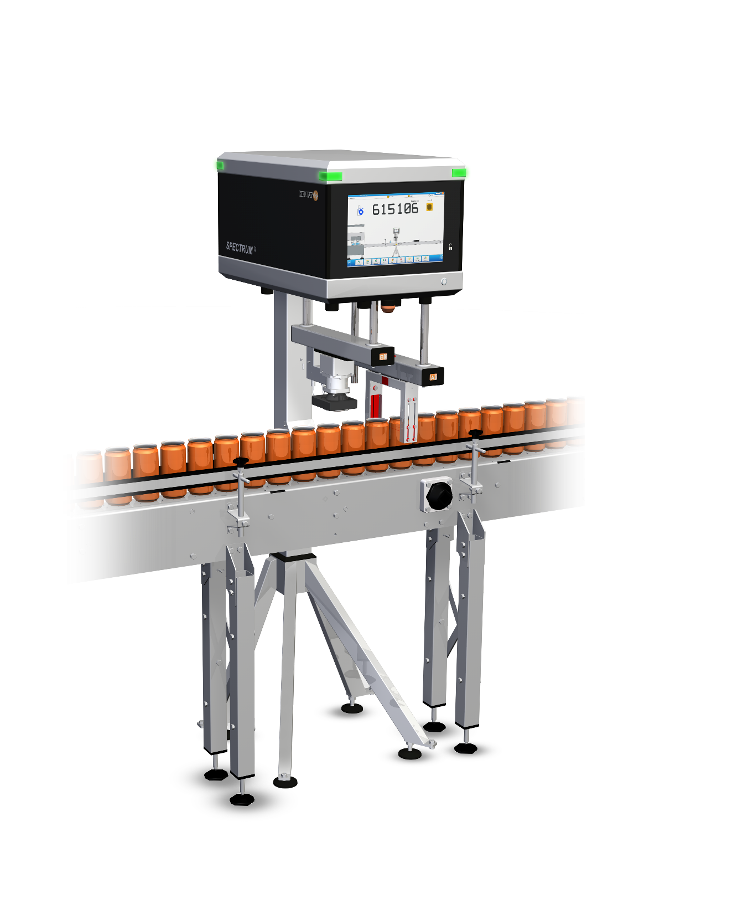
EMPTY CAN INSPECTION
The top-down camera has a slim casing.
Your advantages:
• improved inspection due
to improved illumination
• saves space
A top-down camera with a special LED illumination
is used to take an evaluation picture of flange, base
and inside of every can.
NEW
HEUFT canLine ^{II} – top-down camera

Slide 6
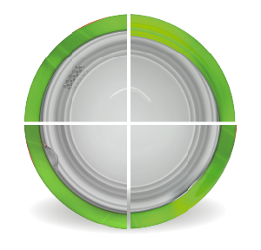
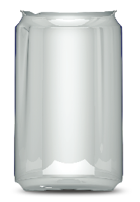
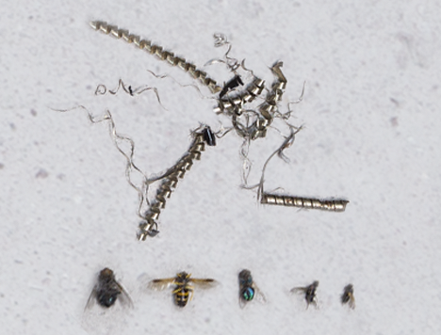
EMPTY CAN INSPECTION
Dents in the
flanged edge
Ovality
Foreign object
Dented inner wall
Dented inner wall
Indentation in the
flanged edge
The HEUFT canLine ^{II} provides a gapless finish, inner sidewall and base inspection of empty cans. Deformation, dirt, foreign objects
as well as flange faults are detected reliably.
Foreign object
HEUFT canLine ^{II} – faults

Slide 7
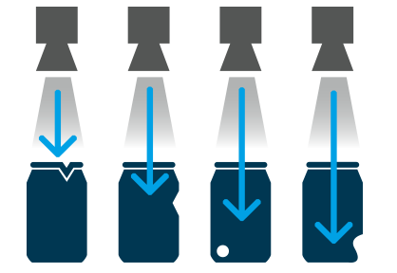
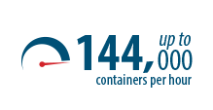
EMPTY CAN INSPECTION
ONE MODULE FULL INSPECTION
A top-down camera with a special
LED illumination is used to take an
evaluation picture of flange, inside
and base of every can.
That way up to 144 000 cans per
hour can be inspected.
HEUFT canLine ^{II} – empty can inspection

Slide 8
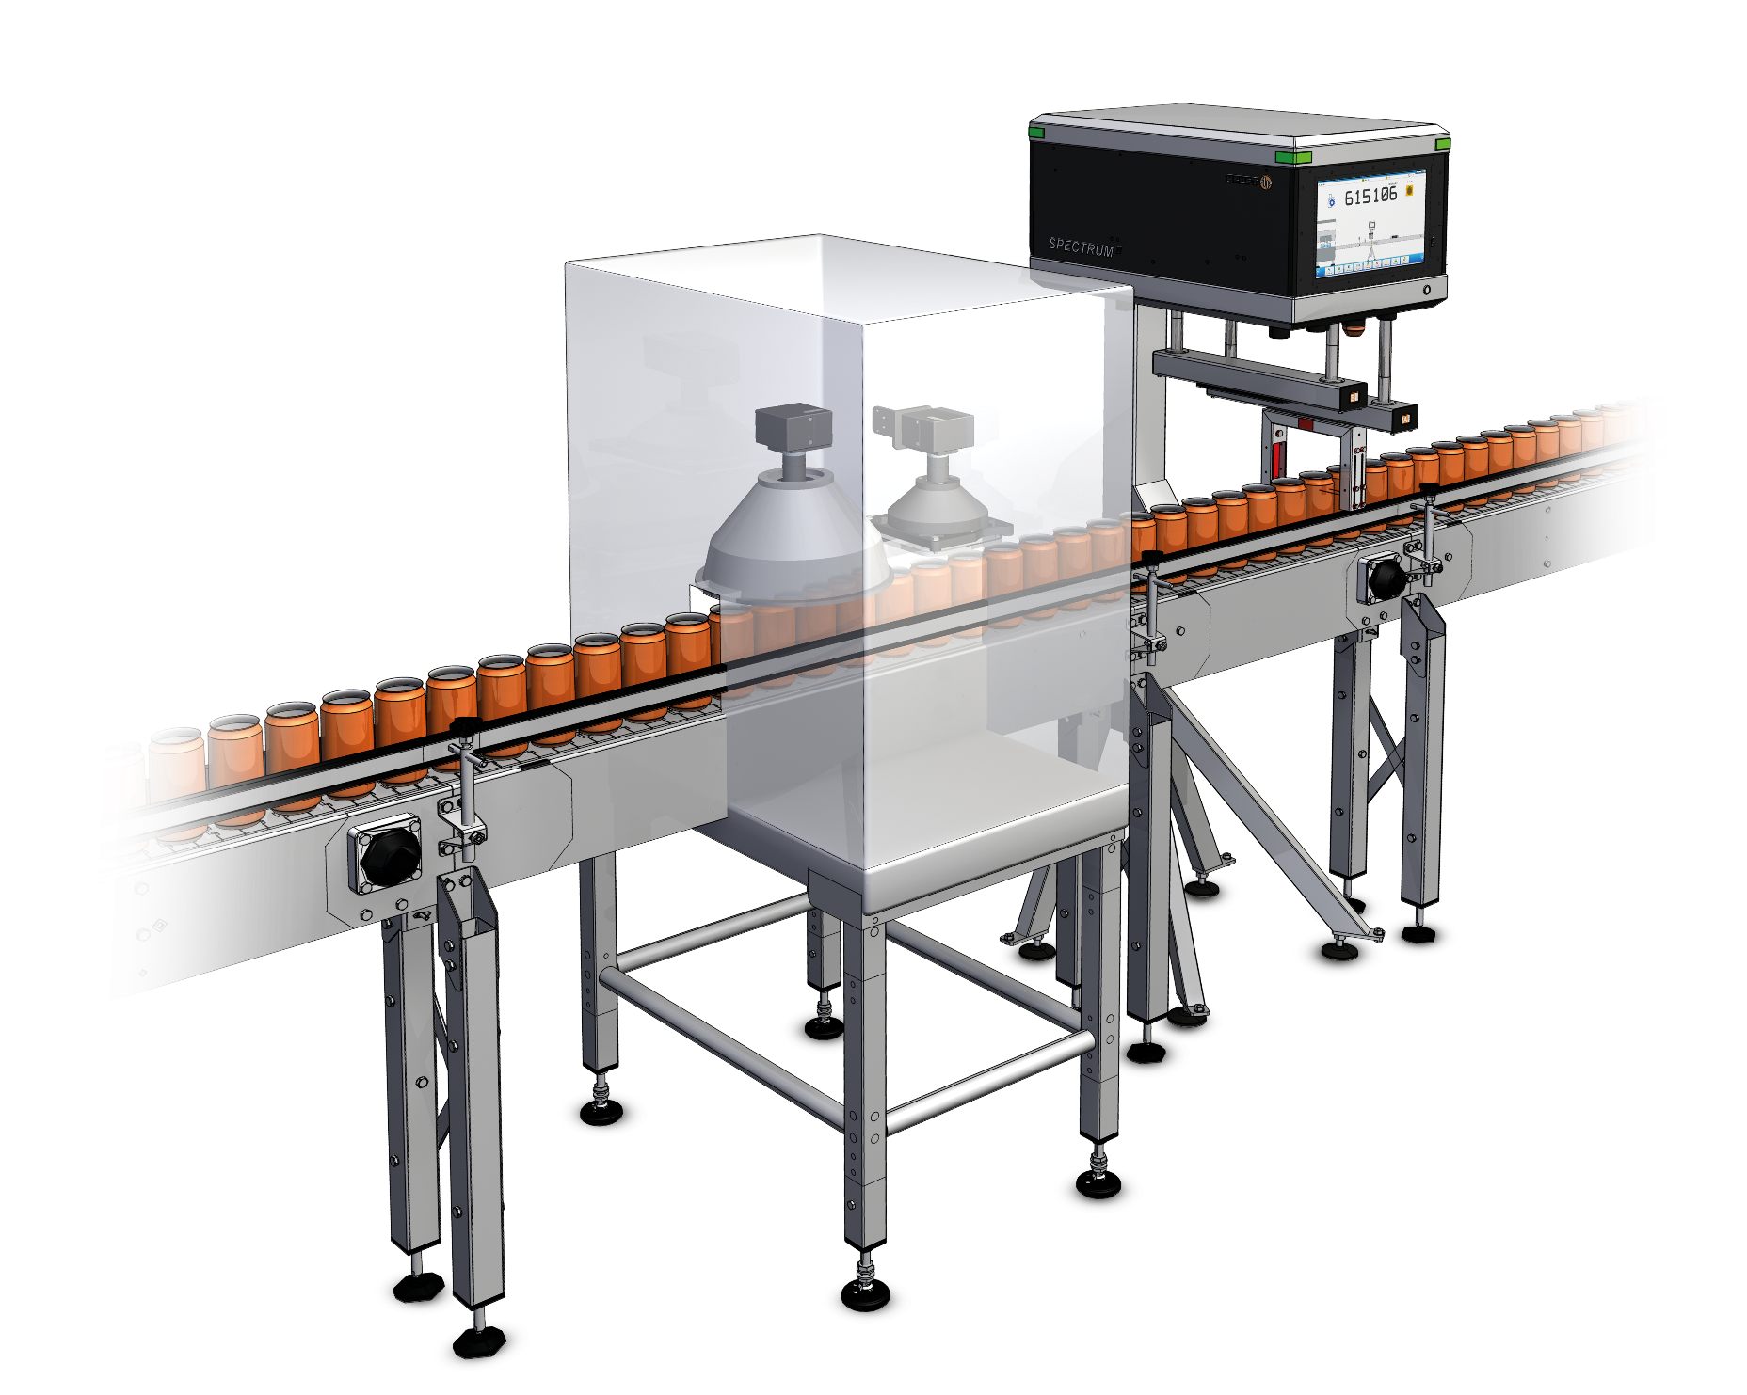
EMPTY CAN INSPECTION
NEW HEUFT canLine ^{II}
A second camera with 8-fold optics improves the inspection below the shoulder.
Your advantages:
• improved inspection ability
• can be selected as a option
The new approach – detecting faults below the shoulder!

Slide 9
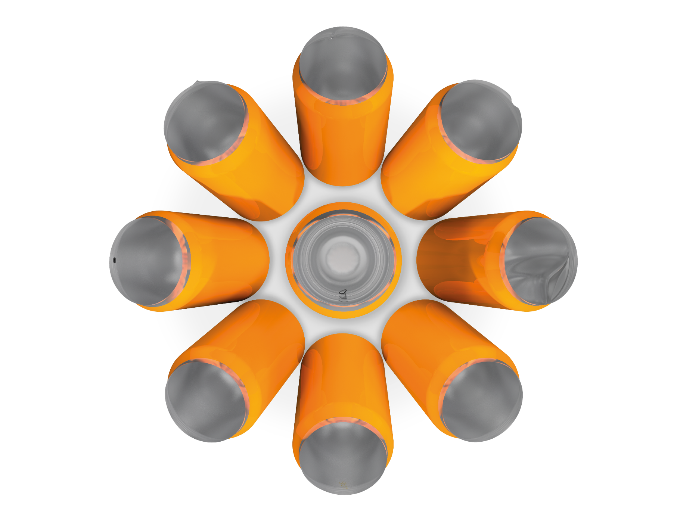
Projection on the
flanged edge
Material flaw
EMPTY CAN INSPECTION
Dents in the
flanged edge
Oval distortion
of the finish
Particle
Dented inner wall
Foreign object
Residual oil
Detecting faults

Slide 10
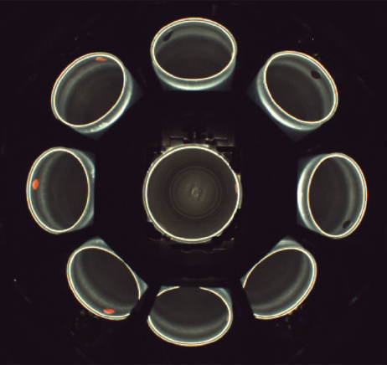
EMPTY CAN INSPECTION
Evaluation picture
HEUFT canLine ^{II} – detecting faults

Slide 11
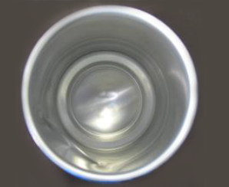
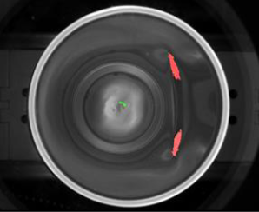
EMPTY CAN INSPECTION
The evaluation software searches for
structures on the inside of the can. Good
structures are taught in during
commissioning. Structures like
dents are evaluated as faulty structures
and marked in red in the
evaluation picture.
Evaluation picture
HEUFT canLine ^{II} – detecting deformations

Slide 12
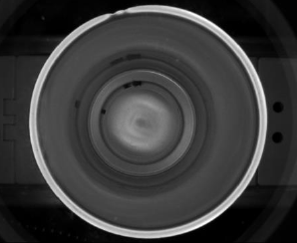
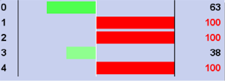
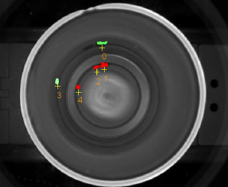
EMPTY CAN INSPECTION
Evaluation diagram
The software searches for objects in the can
using the evaluation.
Objects representing foreign objects are
marked in red.
In the example on the left the evaluation
diagram shows, that the software distinguishes
between the real foreign objects (red) and the
reflections of the dirt in the can sidewall (green).
Evaluation picture
HEUFT canLine ^{II} – detecting dirt and foreign objects

Slide 13
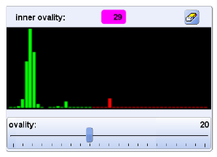
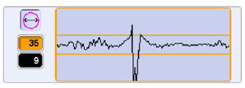
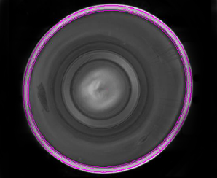
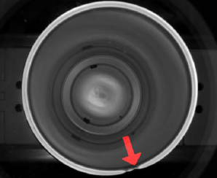
EMPTY CAN INSPECTION
The evaluation software scans the circular structure of the flange to find deviations.
They are market with a red arrow if the deviations exceed a threshold.
Additionally the ovality of the flange is
checked. The can is detected as faulty if it deviates too much from the average and exceeds a threshold.
Evaluation diagram
Evaluation diagram
Evaluation picture
Evaluation picture
HEUFT canLine ^{II} – checking the flange

Slide 14
Detection accuracy
Detection of
Ovality
+/- 1 mm
Faults in the flange
1 x 1 mm
Faults on the base
2 x 2 mm
Dents in the sidewall
app. 3 mm
Dirt on the inner sidewall
app. 2 x 2 x 2 mm
False rejection rate < 0.05 %
Notes:
14

Slide 15
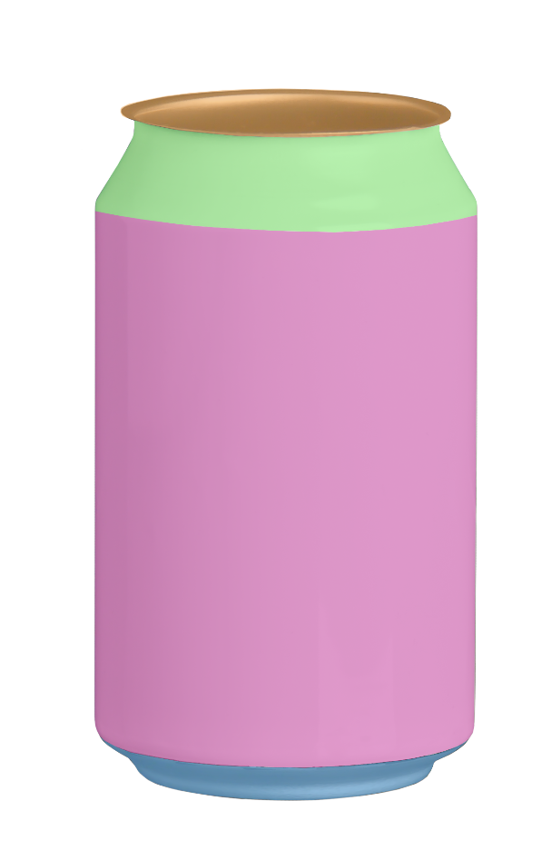
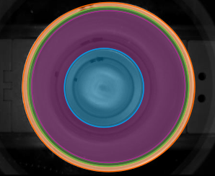
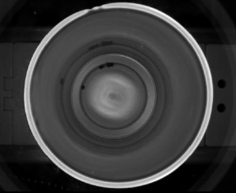
EMPTY CAN INSPECTION
Can areas:
A: flange
Original Gerätebild
B: shoulder
C: sidewall
Inspektionsbereiche
D: base
Inspection areas
Original device image
Dividing the can into different areas

Slide 16
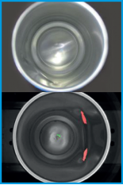
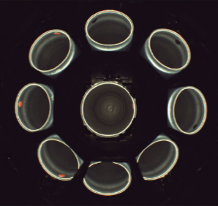
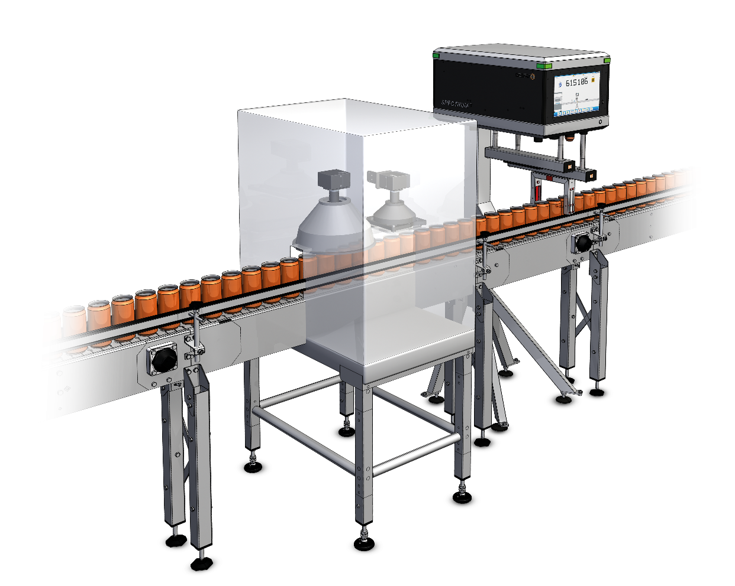
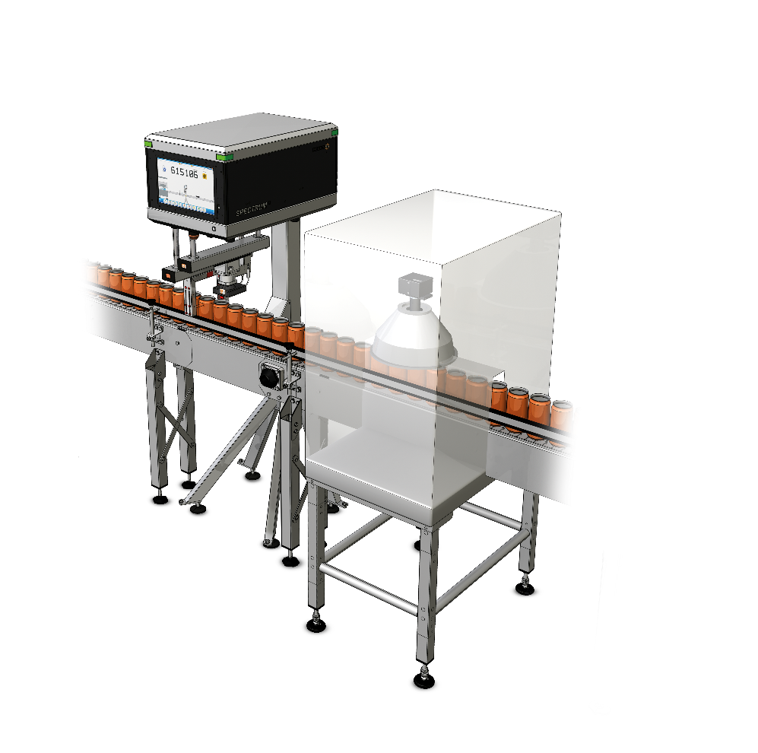
EMPTY CAN INSPECTION
top-down camera
inner shoulder
inspection
top-down camera
at the terminal
inner shoulder
inspection
flexibly positionable
top-down camera
HEUFT canLine ^{II} – structure modules

Slide 17
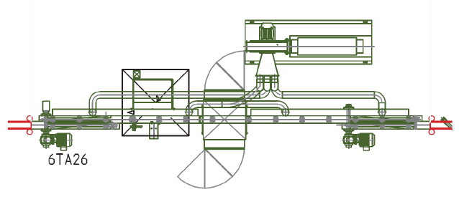
Periphery
The reliable rejection of all the faulty cans from the production flow is carried out by the HEUFT pusher.
Additionally a vacuum conveyor can be installed and provided by HEUFT
to ensure the stable and reliable transport of the empty cans.
Notes:
17

Slide 18
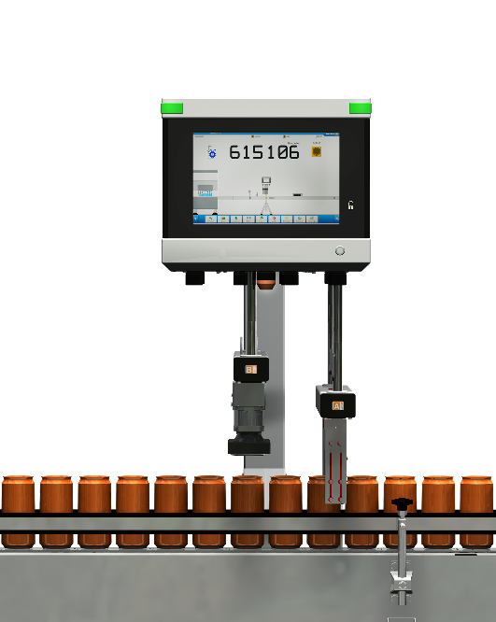
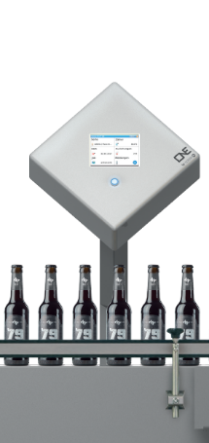
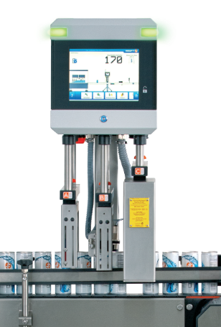
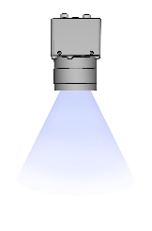
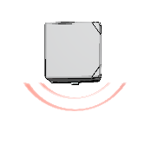
FULL CAN INSPECTION
HEUFT ONE
HEUFT PRIME
HEUFT SPECTRUM ^{II} VX
Different solutions for a full can inspection depending on the requirements

Slide 19
Fill level inspection
Notes:
19

Slide 20
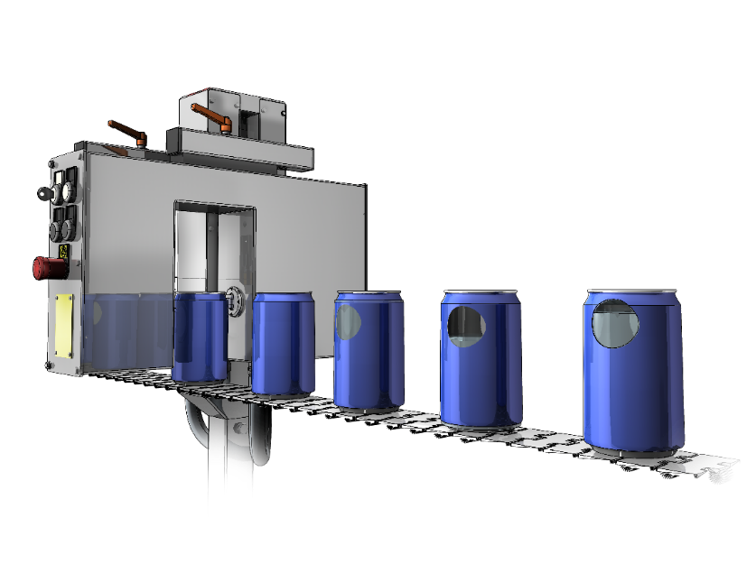
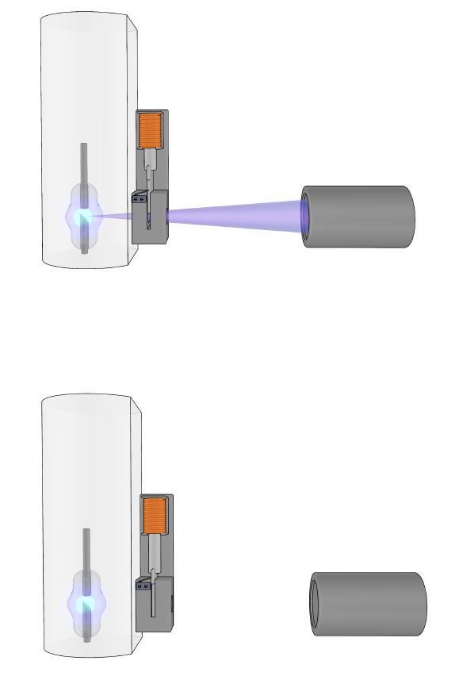
FILL LEVEL INSPECTION
good fill level
underfill
overfill
Lead shutter open
Lead shutter closed
HEUFT X-ray fill level inspection

Slide 21
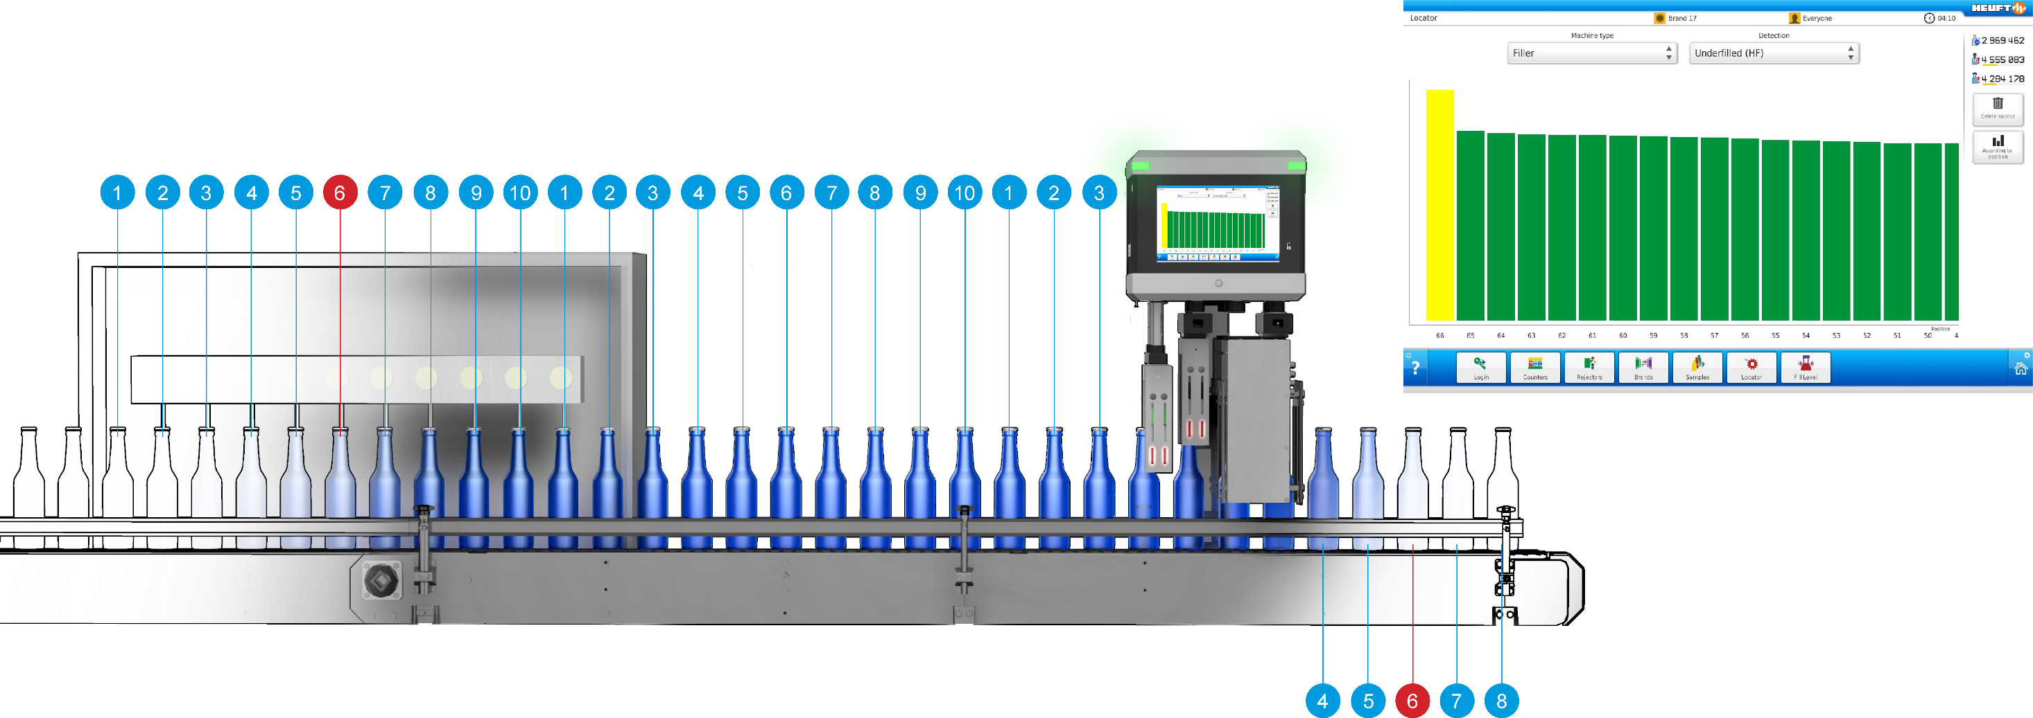
FILL LEVEL INSPECTION
Locator

Slide 22
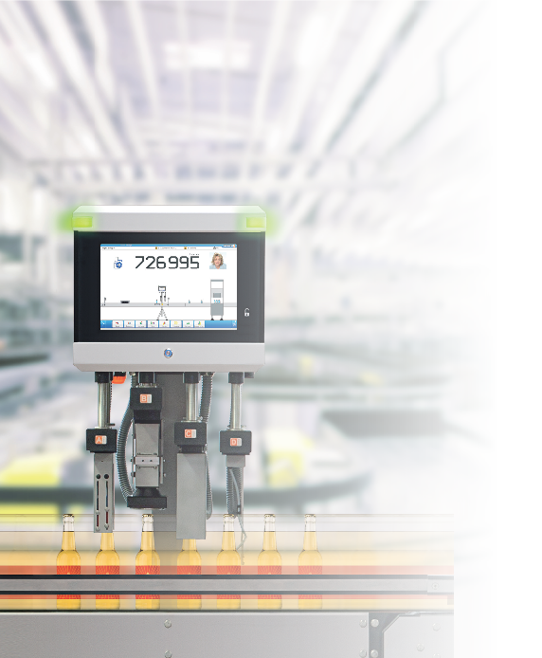
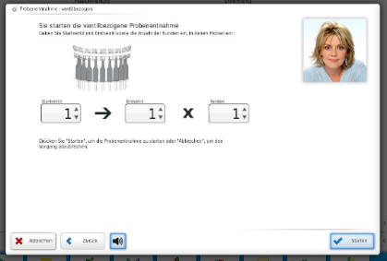
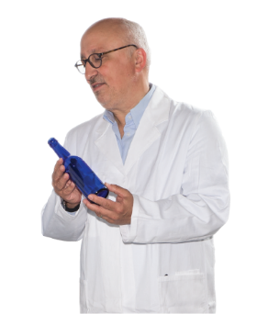
Sampling

Slide 23
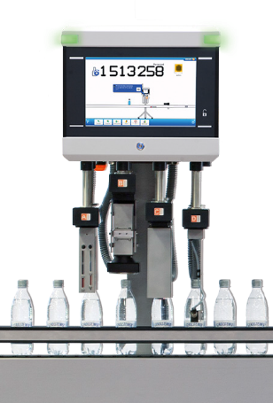
FULL CAN INSPECTION
HEUFT SPECTRUM ^{II} VX
Maximum output 140,000 cont/h
Vertical adjustment devices 4+
Automatic vertical adjustment ✓
Machine connection ✓
Sensor cameras 5
Additional inspection casing ✓
Rejectors 3+
HEUFT NaVi assistance systems ✓
HEUFT checkPoints ✓

Slide 24
FULL CAN INSPECTION
HEUFT PRIME
Maximum output 99,000 cont/h
Vertical adjustment devices 3+
Automatic vertical adjustment optional
Machine connection ✓
Sensor cameras 2
Rejectors 1
HEUFT NaVi assistance systems ✓
HEUFT checkPoints ✓

Slide 25
FULL CAN INSPECTION
HEUFT ONE
Maximum output 72,000 cont/h
Vertical adjustment devices 2
Sensor cameras 1
Additional inspection casing ✓
Rejectors 1

Slide 26
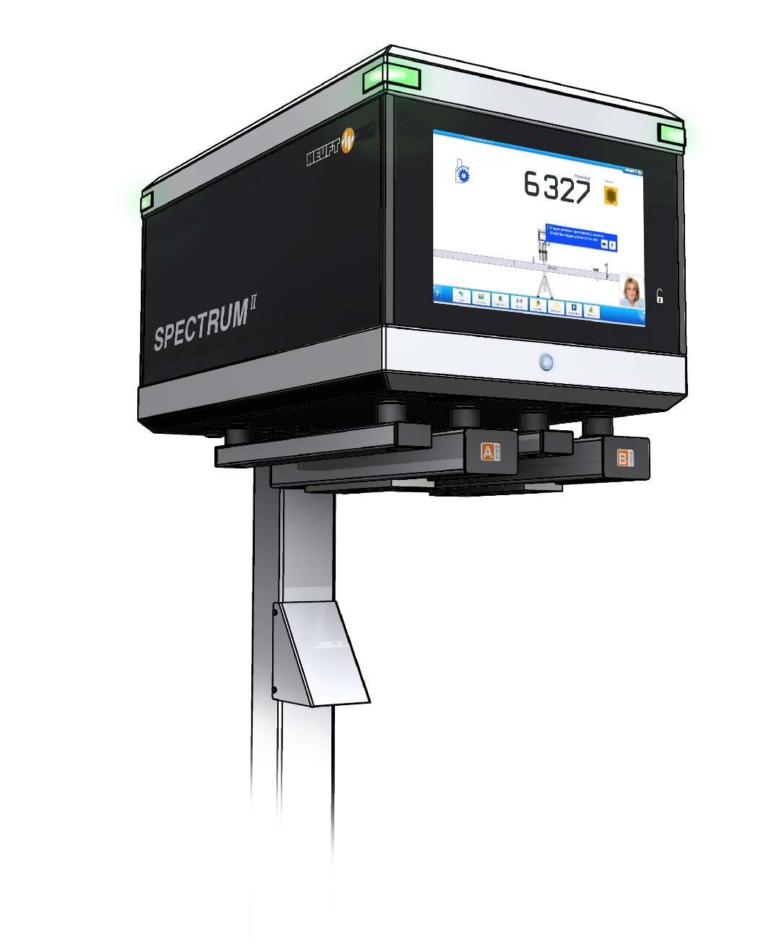
FILLMANAGEMENT
Maximum of 4
HEUFT SPECTRUM ^{II} VX
Modular detection solutions!

Slide 27
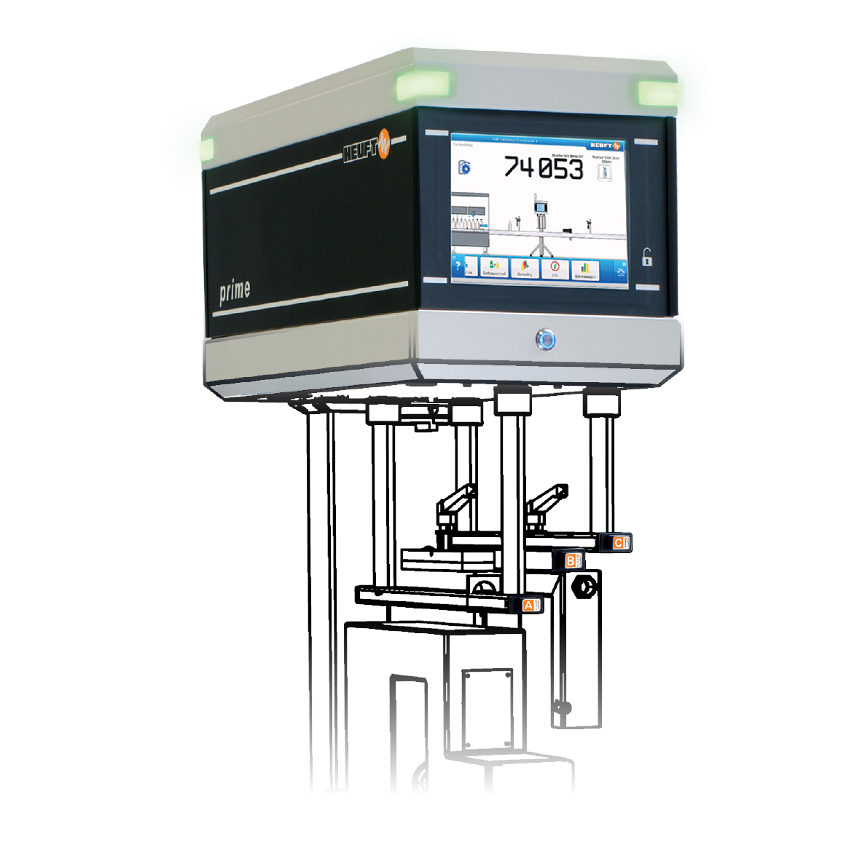
FULL CONTAINER CHECK
Maximum of 3
HEUFT PRIME
Modular detection solutions!

Slide 28
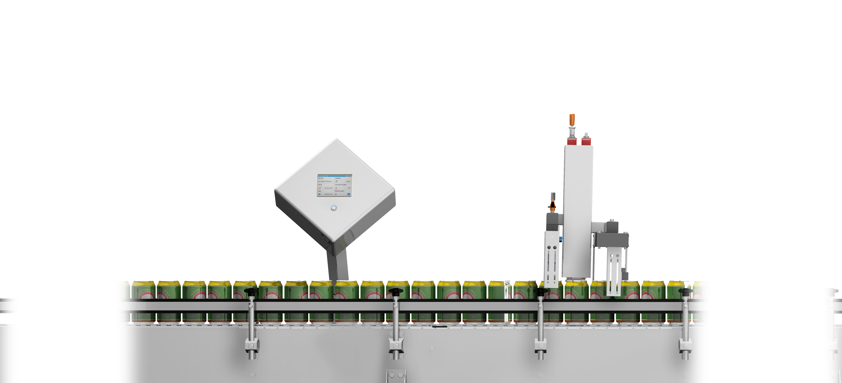
FULL CONTAINER CHECK
^{Intelligent inspection modules}
• fill level detection – HF (+ foam)
• fill level detection – X-rays
^{• camera inspection}
^{Main trigger}
• closure detection (inductive / optical / excessive height)
• pressure check (inductive / cans)
HEUFT ONE
Modular and flexible: combining intelligent inspection modules simply.
Notes:
28

Slide 29
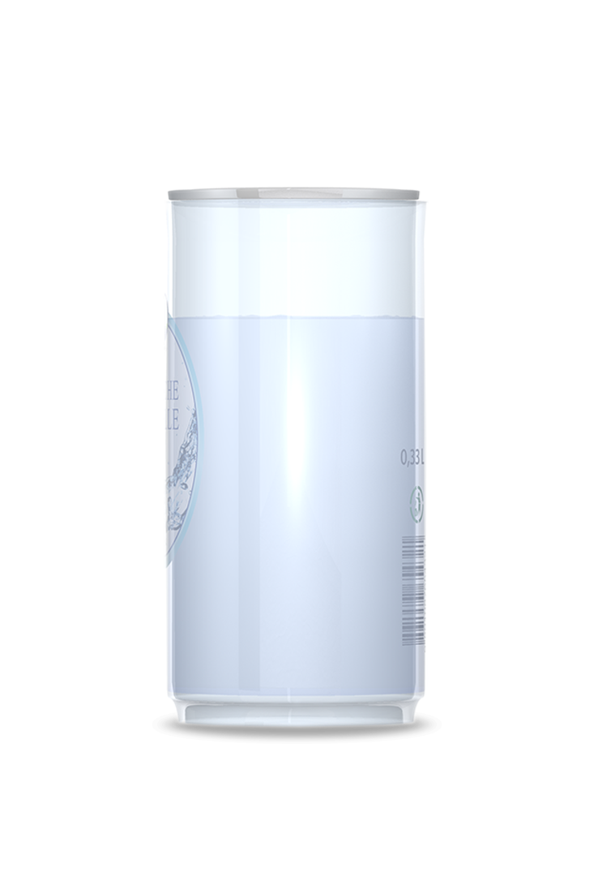
Pressure and leakage check
Notes:
29

Slide 30
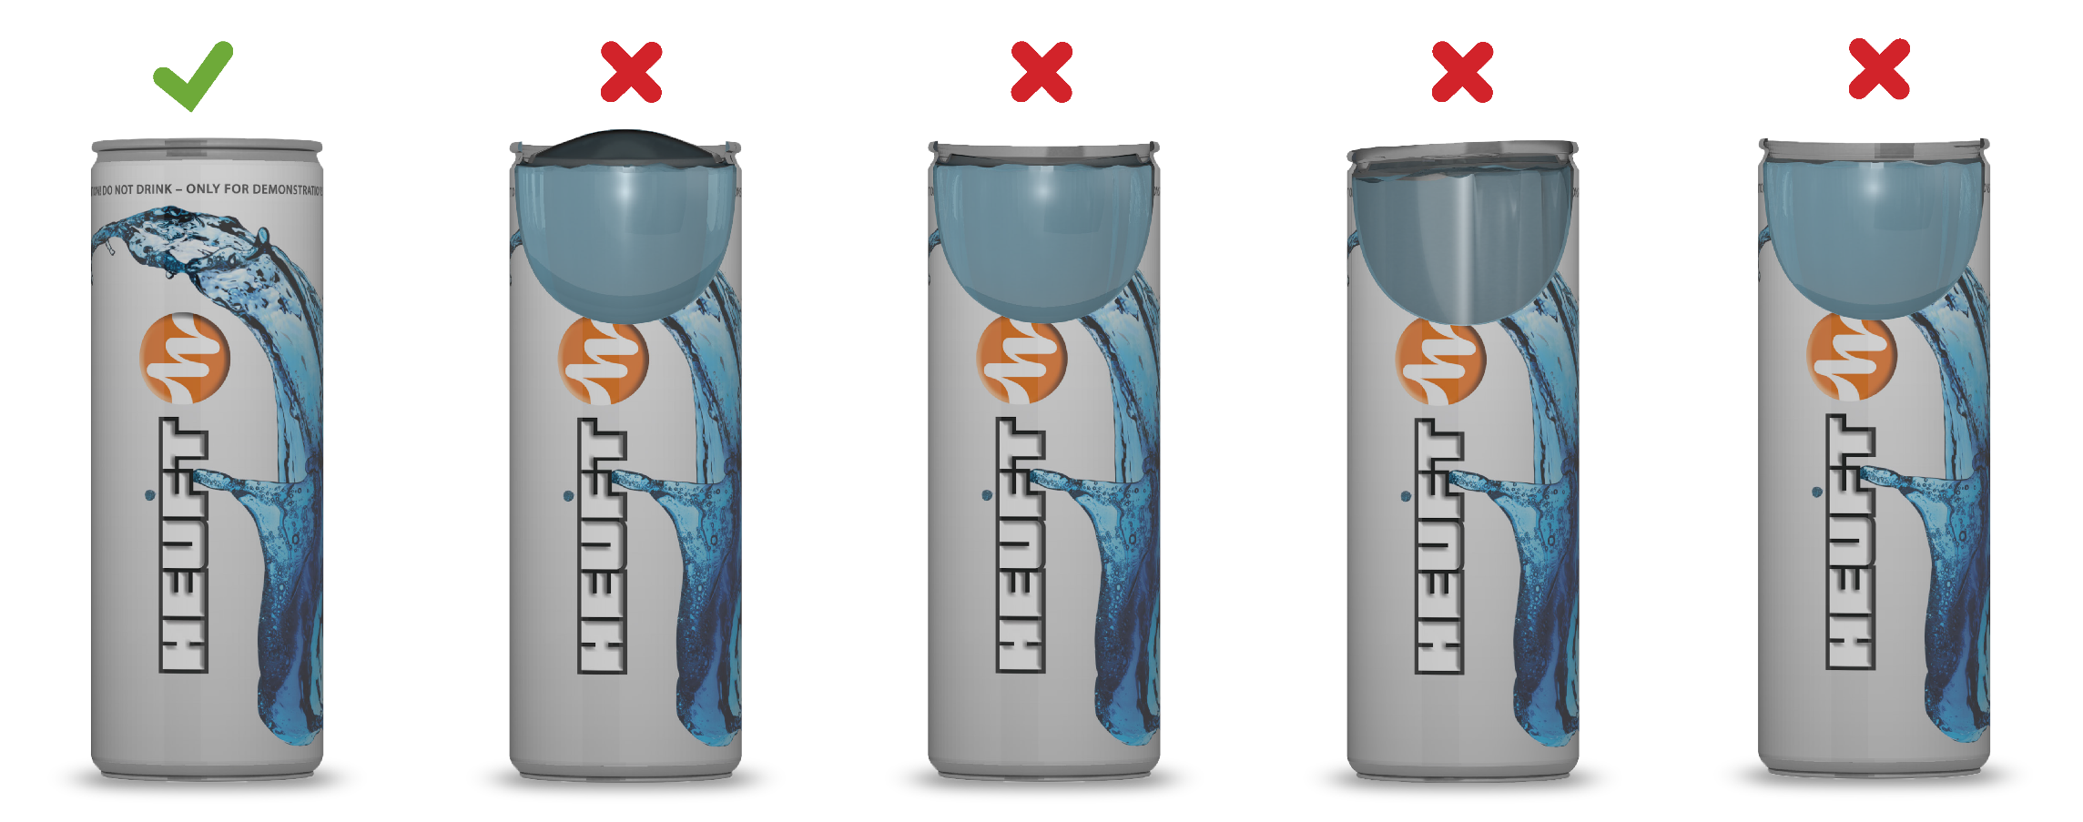
CLOSURE DETECTION
container with excessive internal pressure
container with insufficient internal pressure
closure too high
unsealed container
Inductive pressure check: ensuring the perfect can closure.

Slide 31
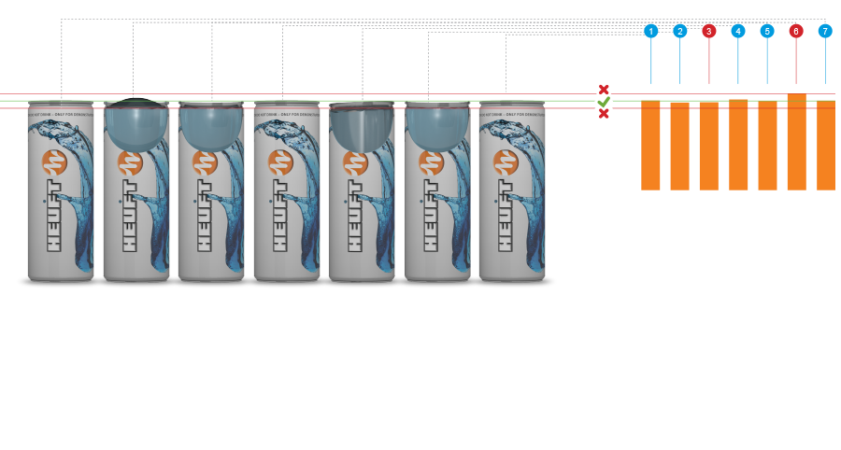
LEAKAGE CHECK
The pressure analysis converts the measured values determined by the "closure detection – pressure" into a unit of measurement. The results are shown graphically as diagrams on the display.
Quantifying – pressure analysis

Slide 32
Code verification
Bar code reading
Code presence
Notes:
32

Slide 33
FOREIGN OBJECT INSPECTION
Space-saving end of line X-ray system of the new generation for a full coverage sidewall inspection.
HEUFT eXaminer ^{II} XS

Slide 34
FOREIGN OBJECT INSPECTION
special chain
base inspection
HEUFT eXaminer ^{II} XS: base inspection

Slide 35
FOREIGN OBJECT INSPECTION
ENLIGHTENMENT
X-ray – base inspection

Slide 36
FOREIGN OBJECT INSPECTION
Pulsed X-ray technology
HEUFT eXaminer ^{II} series
MAXIMUM PRECISION AND
MINIMUM RADIATION!
ENLIGHTENMENT
Pulsed X-ray technology

Slide 37
FULL CASE INSPECTION
Full case and tray inspection for outer packaging in top shape.
HEUFT GX
Notes:
37

Slide 38
FALS REJECTION
HEUFT pusher
HEUFT mono
HEUFT e-mono
HEUFT flip
HEUFT DELTA-FW
HEUFT DELTA-K
compact discharger
careful rejector
high-speed rejector
without Compressed air
smooth rejection
dynamic rejection curve
gentle folding rejector
Notes:
38

Slide 39
OPERATING DATA ACQUISITION
HEUFT PROFILER advanced
HEUFT PROFILER-family
Extension
HEUFT PROFILER
Production data acquisition (PDA) and
line analysis in real time.
HEUFT STRATEGY ^{II} -Server
Upgrade
HEUFT PROFILER elemental
Notes:
39

Slide 40
HEUFT SYSTEMTECHNIK GMBH – heuft.com
Thank you for your attention!

